Slide 1
Teaching Workplace Information Literacy in the Community College
LILAC 2012
Glasgow, Scotland
April 13,2012

Slide 2
From the work of Mike and Nora, focusing on CC Librarianship
Mike Crumpton
Assistant Dean for Administrative Services
The University of North Carolina at Greensboro
macrumpt@uncg.edu
Nora Bird
Assistant Professor, School of Education
Dept. of Library and Information Studies
The University of North Carolina at Greensboro
njbird@uncg.edu

Slide 3
Community Colleges in the U.S.
Date back to 1900
Originally called “Junior Colleges” – first two years to prepare students for University
Now a mix of college preparatory, vocational training, and workforce re-training

Slide 4
Beginnings of Defining the CC Librarian Project
Economic focus on Community Colleges
WILIS study of librarians in North Carolina, USA
IMLS grant to Northern Illinois Library Consortium
Nature of Community College Librarianship, unique skill set
Diversity of staff vs. students served
Project website

Slide 5
Enjoying New Attention

Slide 6
Project Plan
Assessment
Surveys
Focus groups
Field literature
Identification of skill set(s) needed
DACUM
Detailed assessment
Course design
Temp to perm
Professional development
LIS course
Evaluation
Book to celebrate uniqueness

Slide 7
Survey – May 2010
190 respondents
NC, SC, VA & some nationally
Looked at gender, degree, coursework, skills learned since degree, titles
Some demographic info
Over 70% surveyed has middle or early college programs
High percentage of distance education support
Others listed…………….

Slide 8
On the Job Skills

Slide 9
Languages

Slide 10
What’s Home base perspective?

Slide 11
DE Instruction

Slide 12
Desired Skill Sets

Slide 13
Unique Challenges of CC Libs
Working with diverse clients/patrons
Workforce and lifelong learning issues
Dealing with early and middle colleges
Small staffs and personal skills employed
Distance education programs
Management and administrative skills
Adult learning and andragogy skills
Resource specialization
Workplace information literacy and ID

Slide 14
General Community College curricular purposes:
Academic transfer preparation
Vocational-technical education
Developmental education
Continuing education
Community service

Slide 15
Information Literacy
According to many definitions, the information literate person “must be able to recognize when information is needed and have the ability to locate, evaluate, and use effectively the needed information.” (American Library Association, 1989)
Challenge is: Would you define Workplace Information Literacy differently?

Slide 16
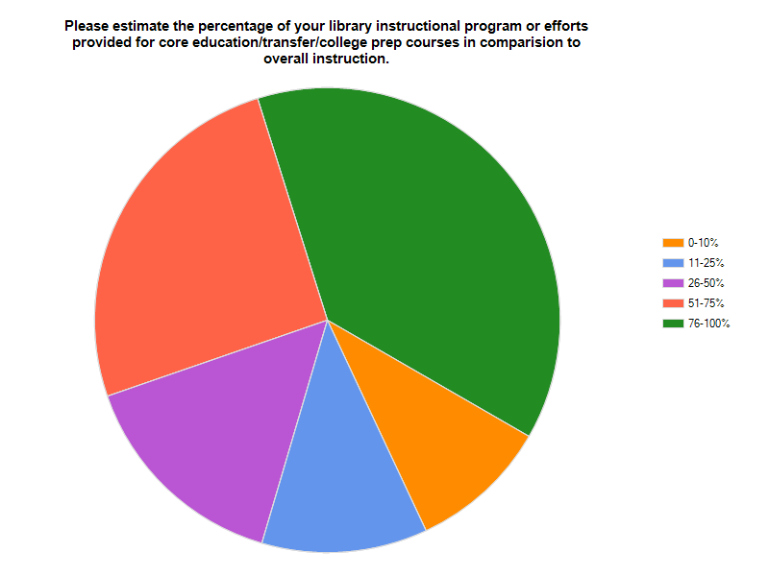
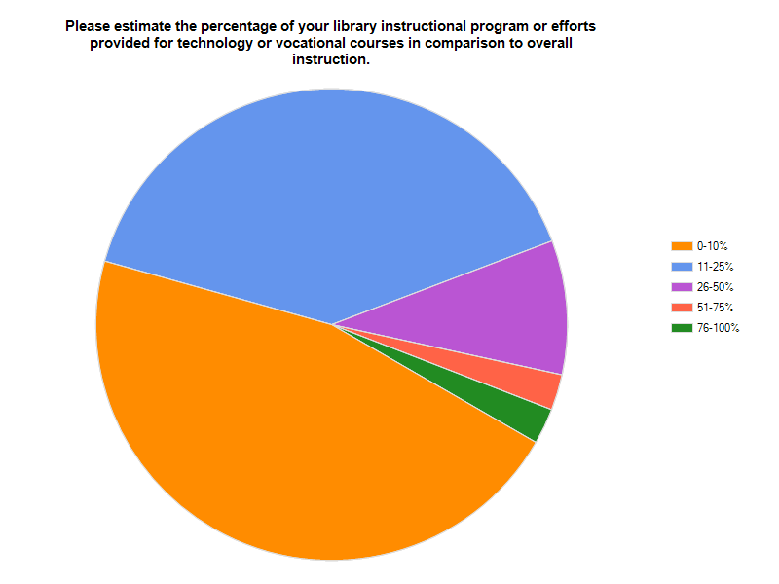

Slide 17
Annemaree Lloyd’s Work
“Information literacy landscapes: Information literacy in education, workplace, and everyday contexts”
Her title says it all. Context is essential to the process. There is no universal information literacy.
The focus has been on academic information literacy.
Notes:
Very few “blue-collar” vocations have been studied – Crawford & Irving worked with nursing home staff, Lloyd worked with firefighters, but what about police officers, plumbers, auto mechanics, etc.

Slide 20
Focus Groups
Confirmed the impression that vocational programs are underserved
“I don’t know many people who have HVAC degrees... If HVAC approached me to do an [IL class] I’d have to get familiar enough to be able to answer subject-specific questions. That’s a mammoth job.”

Slide 21
Also from the focus group
“ …I think their comfort level with us. Yeah, they may know how to do that, but the ones [instructors] who come back all the time believe that we do a better job –they don’t try to do our job for us, just like we don’t teach English … I think that they see us as professionals in the same way that they are.”

Slide 22
Lifelong learning
“We led a session on our staff development day where people can choose to take our workshop at the library, and the information technology people loved it because in NC Live there’s a place you can go where you work on certain cars. The depth of the knowledge is for real people, it’s not just academic. Yeah, I think the workplace and the fact that we have older students could be developed.”

Slide 23
Producing IL Equity
Re-investment of time into addressing issues of equity in information literacy teachings:
Emphasis on explicit instruction
Addressing economic, social and political factors
Early student engagement
New “conceptualizations” of reading
IL as practice
Insights from workplace information literacy

Slide 25
IMLS Grant Goals
Develop series of continuing education modules, based on research via MLIS
Employ “Teacher-Librarian-Faculty” practicum for MLIS students
Grow continuing education coursework into full-course development for MLIS program
Resource developed for widespread distribution and support of curriculum content, such as a textbook

Slide 26
Original Grant Feedback
Scope of project good on reg and nat level
Diversity elements important
Program could have impact in addressing needs not for CC Lib
Program could be sustainable
More differences between cc libraries and academics needed
More research needed to focus on core competencies needed
Include CC Faculty in DACUM
Focus on training differences
Positive
Critical

Slide 27
Intended Results
Background Issue | Result | Favorable Attribute
Lack of diversity in community college librarians (90% white) | Librarians ready to serve the diverse community college student population. | Recruit diversity candidates from the MLIS student population into the teach-librarian practica.
Workforce learners | Training in workplace information literacy | UNCG DLIS has recently launched research into this area.
Mid-career training needs | Continuing education modules based on the DACUM model. | Identification of needs from constituencies to strengthen community college librarianship.
Retirement of CC librarians | MLIS students with strong practicum experiences. | Employing the Teaching-Library-Faculty model.
Lack of LIS community college research agenda | Involvement of the research team in community college based issues. | Empirical base for research and new knowledge.

Slide 28
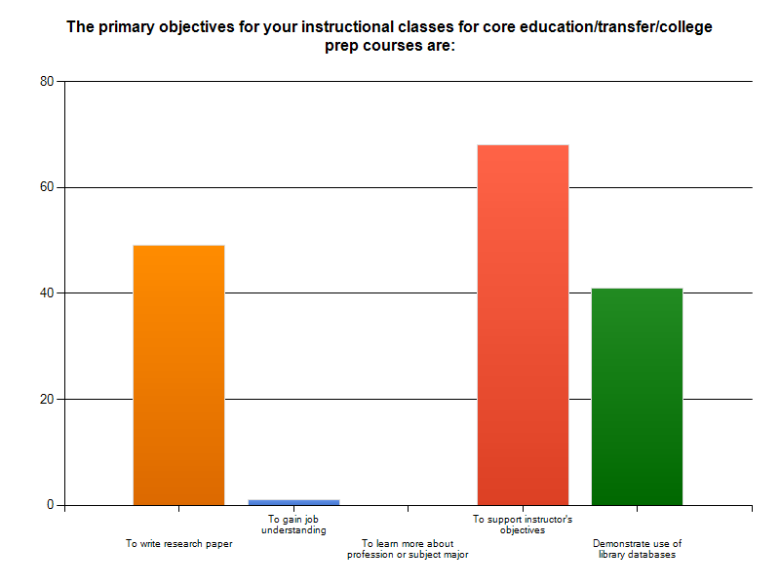
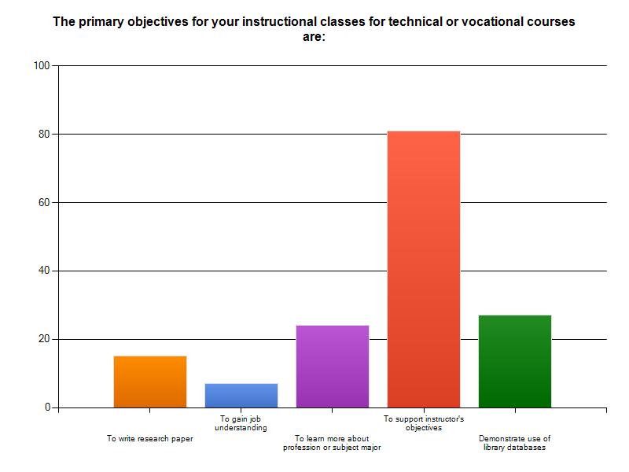
Instructor Objectives key!
Disparity with papers and jobs

Slide 29
Working with Instructors
Subject Matter Experts
Course specific needs
More resources, less academic structure
Request job related resources
Web evaluation skills important

Slide 30
McGill’s Continuing Education
Addresses information literacy for continuing education curriculum
Addresses diverse learning objectives and needs of CE students
Andragogy
Culture and language
Active environments
Instructor awareness
Of options available
Of need for including IL within coursework

Slide 31
JMU - Employer Expectations
Research study
Types of information in the workplace
Information tools used in the workplace
Activities performed by research and information
Research skills needs
How do graduating students measure up?
Results recommend a more varied approach to information literacy instruction

Slide 32
Crawford and Irving’s Human Element
Key role of human relations in the workplace to foster information literacy
Proactive consultation with agencies involved in skill development and training
Provide internally benchmarks, resources and space dedicated to fostering IL growth

Slide 33
Writing Objectives for Library Instruction
SME = primary faculty member
Behavioral objectives =
Demonstrated behaviors
Action verbs
Expected level of achievement
Cognitive objectives =
General instructional objective (learning domain)
Specific types of performance

Slide 34
Implementation Strategy
CLER
Configurations
relationships
Linkages
Org links, i.e. course
Environment
Physical, social and intellectual forces
Resources
Support mechanisms

Slide 35
Kirkpatrick’s 4 Levels of Training Evaluation
The four levels of Kirkpatrick's evaluation model essentially measure:
REACTIONS-What they thought and felt about the training
LEARNING-The resulting increase in knowledge or capability
TRANSFER-Extent of behavior and capability improvement and implementation/application
RESULTS-The effects on the business or environment resulting from the trainee's performance

Slide 36
ADDIE Model
The ADDIE instructional design model is the generic process traditionally used by instructional designers and training developers. The five phases—Analysis, Design, Development, Implementation, and Evaluation—represent a dynamic, flexible guideline for building effective training and performance support tools.

Slide 37
Outcomes Assessment
Ohio State case study
Assess course objectives
IL goals and librarian relationships
Instructor’s perspective
Measured
Instructor satisfaction with student work
Compared library instruction for outcomes
Opportunity for supportive instruction

Slide 38
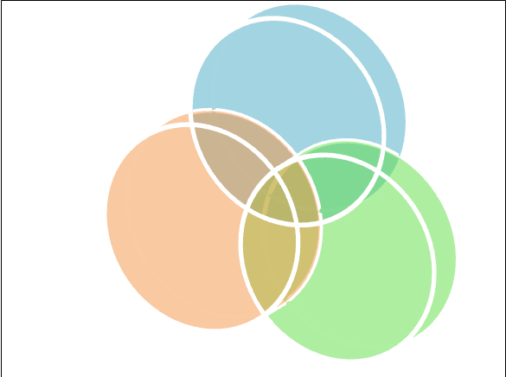
Real Learning Connections Project
Current Theory
and Research
LIBRARIAN
Practical Work Experience
FACULTY
STUDENT
Academic Content

Slide 39
Community College Partners
Each member of the class is linked with a practitioner in a community college.
Checking theory being learned from articles with what is being done in libraries.
They will write about the connections and disconnections.

Slide 40
Training vs. Education
Practice
Taking action
Focus on performance
Knowledge content
Educating first
Theory
Cultivate minds
Knowledge
Change to known's
Training for something
Training
Education

Slide 41
Post-Literacy Considerations
Skimming not reading
Scanning of information represented visually
Digital engagement

Slide 42
In Summary
Community colleges and their libraries serve a broad range of needs, including vocational/technical programs needing different information skills
Need for workplace literacy instruction strong
Advocacy needed for support of this unique environment
Uniqueness translates into broader range of skill sets for librarians
Workforce changes still trending high, challenges for librarians will increase

Slide 43
References and Readings
Bird, Nora J., Michael A. Crumpton, Melynda Ozan, and Tim Williams. "Workplace Information Literacy: a Neglected Priority." Journal of Business & Finance Librarianship 17.1 (2012): 18-33.
Dowell, D. (2006). Introduction. In D. Dowell (Ed.) It’s all about student learning: Managing community and other college libraries in the 21st century. Westport, CT: Libraries Unlimited.
Karp, R. (2006). Leadership issues for community college librarians. In D. Dowell (Ed.) It’s all about student learning: Managing community and other college libraries in the 21st century. Westport, CT: Libraries Unlimited.
Kirkpatrick, Donald L. Evaluating Training Programs. New York, NY: Berrett-Koehler, 1994.
Lloyd, A. (2010). Information literacy landscapes: Information literacy in education, workplace, and everyday contexts. Oxford, UK: Chandos Publishing.
Lloyd, A. and Williamson, K. (2008). Towards an understanding of information literacy in context: Implications for research. Journal of Librarianship and Information Science, 40(1), 3-12.
Marshall, J. G., Marshall, V. W., Morgan, J. C., Barreau, D., Moran, B. B., Solomon, P., et al. (2005). Workforce issues in library and information science (WILIS). UNC Institute on Aging and UNC School of Information and Library Science: Institute of Museum and Library Services.
O'Hanlon, Nancy. "Information Literacy in the University Curriculum: Challenges for Outcomes Assessment." Libraries and the Academy 7.2 (2007): 169-189. Web. 2 Feb. 2012.
Patterson, David. "Information Literacy and Community Colleges Students: Using New Approaches to Literacy Theory to Produce Equity." Library Quarterly 79.3 (2009): 343-361.
Provasnik, S. and Planty, M. (2008). Community Colleges: Special Supplement to The Condition of Education. Statistical Analysis Report. Washington, DC: National Center for Education Statistics.
Warren, Leslie A. "Information Literacy in Community Colleges." Reference & User Services Quarterly 45.4 (2006): 297-303.

