Slide 1
Grumble Theory in the Workplace
Motivating the grumbles
Notes:
All HR professionals one of the challenges we have had to face in recent years is morale and engagement. As employees of state government, we’ve seen several years of budget cutbacks take their toll on employees. How many people in this audience find morale challenges to be a struggle?
In our session, we are going to discuss the morale challenges we faced in our organization and how we responded.

Slide 2
Presenters
Michael Crumpton, MLS, SPHR
Kathy Bradshaw, MLIS, SPHR
University Libraries
University of North Carolina at Greensboro
Notes:
We will share a tool that provided for us an internal assessment of our libraries organizational climate, call ClimateQUAL. We’ll also discuss how the findings of this assessment lead us learning more about Maslow’s Grumble Theory and how this can be a precursor to formal complaints or grievances.
And we’ll discuss how to use Grumble Theory in the context of Maslow’s hierarchy of needs.

Slide 3
Motivation
“WHY” of behavior
Psychological phenomena not directly observed
Connection between need satisfaction and psychological health
Making sense of observed behaviors
Notes:
Defining motivation, it’s the art of helping people to focus their minds and energies on doing their work as effectively as possible. Saul W. Gellerman, Motiviation in the Real World
Herzberg’s Motivation-Hygiene (maintenance) Theory
Fixity and degrees of motivation

Slide 4
Behaviors
Behaviors
Initiation
Energization
Direction
Historical references
Instinct
Drive theory
Learning
With stimulus
Behaviors are motivated
Must also consider:
Biological
Cultural
Situational

Slide 5
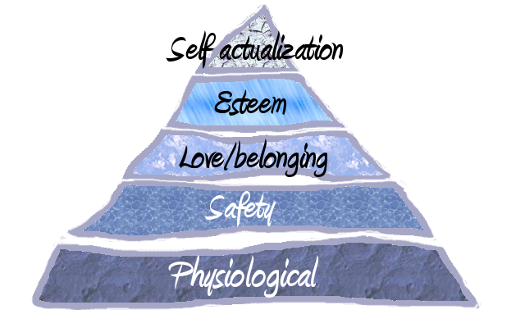
Maslow’s Hierarchy of Needs
Basic keys to motivation
Notes:
Most of you are probably familiar with Maslow’s Hierarchy of Needs, which are considered to be the basic keys to motivation. In our organization, we are limited in our ability to provide motivation incentives such as salary increases or bonus time. In fact, due to drastic budget cuts in our state, raises had not been given in several years and promotions were limited. While we were able to attribute the declining morale completely to economic issues, we knew there were other issues involved. As a way to asses our organizational climate, we administered a tool called “Climate Qual.” Climate Qual is an organization assessment tool, used exclusively by libraries. We will get to more detail about ClimateQual in the next slide.
The results of our assessment showed us that staff members had many concerns, some of which could directly be attributed to the declining morale. In an effort to try and resolve some of the issues presented, we engaged the services of an adjunct faculty member to conduct focus groups with library staff in an attempt to obtain more specific information about the problems and difficulties the staff were having.

Slide 6
What is climatequal®?
Notes:
ClimateQUAL®: Organizational Climate and Diversity Assessment is an assessment of library staff perceptions concerning (a) their library's commitment to the principles of diversity, (b) organizational policies and procedures, and (c) staff attitudes. It is an online survey with questions designed to understand the impact perceptions have on service quality in a library setting. The survey addresses a number of climate issues, such as diversity, teamwork, learning, and fairness, as well as current managerial practices, and staff attitudes and beliefs.
ClimateQUAL® aims to:
* Foster a culture of healthy organizational climate and diversity;
* Help libraries better understand staff perceptions of organizational climate and diversity;
* Facilitate the on-going collection and interpretation of staff feedback;
* Identify best practices in managing organizational climate; and
* Enable libraries to interpret and act on data.

Slide 7
process
Implementation team
Marketing of concept
Survey
Initial results
Focus groups
Solution gathering
Actions identified
Low cost solutions
Re-assessment

Slide 8
Results and grumbles
EPA/SPA = exempt/non-exempt = manager or not
Staff recognition
MBWA
Organization is siloes (petty tyrannies)
Communication (how resolved)
Transparency of management
Meetings more 2 way
High grumble
High grumble
Meta-grumble

Slide 9
Pre-potency
Stronger
Must be satisfied first
Becomes order driven
Notes:
Needs in hierarchies, appearance of one need usually rests on the prior satisfaction of another need.
Needs are not isolated or discrete, every drive toward a need is related to the state of satisfaction (or dissatisfaction) of other needs.

Slide 10
Workplace Grumbles
Notes:
While managers and supervisors (with HR as a partner) should certainly welcome the opportunity to address employee concerns, the question that many managers face is at what point does an employee concern cease being a valid concern? Enter “Grumble Theory.”

Slide 11
Grumble Theory
Low Grumbles – complaints regarding biological or physiological needs satisfaction
High Grumbles – concerns over esteem and/or self-esteem issues
Metagrumbles – higher level complaints concerns value of human life, truth, justice, beauty, perfection, etc.

Slide 12
Low Grumbles
Food
Sleep
Shelter
Health
Workplace
Safety
Comfort
Non-restrictive
Notes:
Compare “low grumbles” to Maslow’s Hierarchy of Needs” theory. I think everyone can agree that workplace concerns involving safety, comfort should be addressed immediately. Now comfort may be considered subjective, such as when one employee likes the temperature at 75 degrees and another wants the temperature maintained at 65 degrees. Low grumbles initiate when the first levels of Maslow’s needed (physiological and safety) aren’t being addressed.

Slide 13
High Grumbles
Dignity
Self-respect
Respect from others
Praise
Rewards
Worthiness
Preconditioned that basic needs are met
Notes:
High grumbles correlate to the upper level of Maslow’s theory-love/belonging and esteem. High grumbles won’t originate from employees who have low grumbles.
Each individual organization will determine how to define its own culture and how that culture will be reinforced. We work at a university, and within the larger University, there are numerous subcultures; what is troubling to someone in the library may not be an issue for someone that works in student financial aid.
One thing that make the higher education community is the issue of what is called “shared governance” which means that there are three internal groups which have a say in the running of the campus: faculty, staff and students. As an example, one of the issues that came up as a troublesome area was the issue of “transparency.” For us transparency meant that staff felt that decisions were being made and they not only weren’t consulted prior to the decision, but that the rationale for these decisions was not disclosed (or it was not disclosed to their satisfaction. )

Slide 14
Metagrumbles
Beauty
Perfection
Meta-needs
Justice
Truth

Slide 15
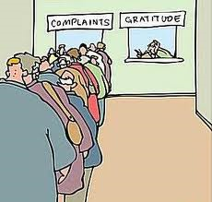
Humans will always complain
Notes:
Per Maslow, “man is a perpetually wanting animal”

Slide 16
Maslow
-high level self-actualizers focus on moving forward with their lives, according to their values, avoid blaming or resenting others and learn from past experiences-
-”What a man can be, he must be”
Notes:
According to Maslow’s hierarchy, those that that are at the level of self-actualization do not have to focus on lower level needs such as safety, food, etc. since those needs have been me. To translate that to an employment perspective, those employees whose physiological, safety, desire to belong and esteem needs are the ones making the metagrumbles. It isn’t that the concerns by these employees are valid, but it will have to be determined by each individual organization how and in what manner to address the grumbles.
Self-actualized is what someone is potentially.

Slide 17
Self-actualization
Self-aware, focused on personal growth
Interest is with fulfillment of personal accomplishments or intended destiny
Self-indulgence = enjoyable
Meta-regulation of mood
Notes:
Fulfilling self-esteem, based upon real capacity, desire for strength, achievement, confidence and secondly desire for reputation or prestige
Once self esteem is fulfilled, the awareness is about the potential

Slide 18
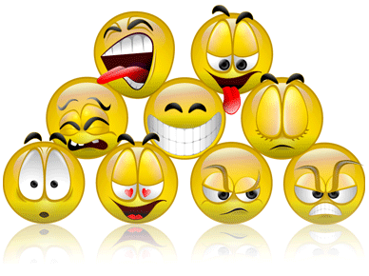
motivation
Intricately linked to emotions
Impacts social achievement goals
Regulated with EI
Notes:
Human motivation is intricately tied to emotions. Employee motivation directly impacts social achievement goals (including those on the personal side) and is correlated to emotional intelligence. How many in the room are familiar with the concept of emotional intelligence? Are there people in the room that have spent time incorporating the principles of emotional intelligence in the workplace?

Slide 19
Motivation and EI
Motivation
Emotional intelligence
Enthusiasm
Initiative
Persistence
Positive attitude
Creativity
Passion
Optimism
Drive
Notes:
Take a look at this chart and look at the key concepts of motivation and look at the corresponding concept of emotional intelligence.

Slide 20
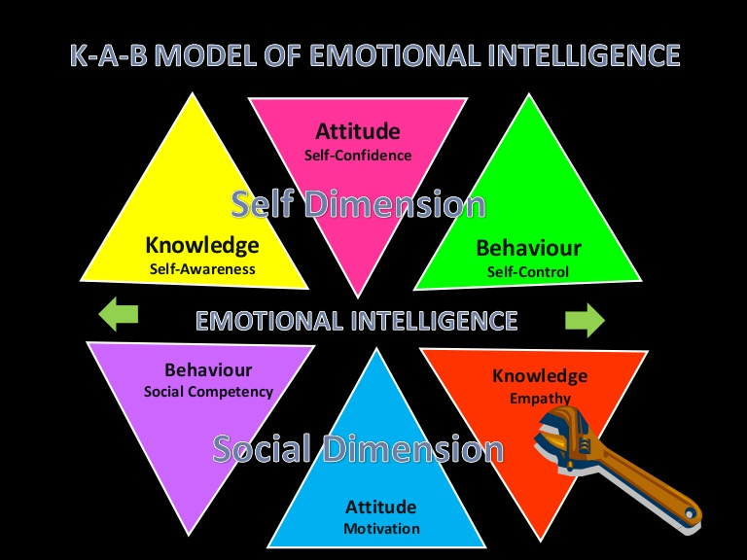
Emotional intelligence
Notes:
Let’s take a look at the K-A-B Model of Emotional Intelligence.

Slide 21
Grumbles vs. complaints
Harassment
Bullying
Justice
Pay
Assignments
Fairness
EEO issues
Job satisfaction

Slide 22
Associating the Grumbles
Low grumbles >>>>> smoke, conflict, disagreement
High grumbles >>>>>> bullying, harassment
Meta grumbles >>>>>> toxic environment, disarray

Slide 23
Addressing the pre-conditions
Are basic needs met in the workplace for comfort, i.e., temperature, ergonomics, lighting, etc.
Are safety concerns addressed; security, OHSA standards, MSDS compliance, etc.
Are recognition programs in place to provide opportunities to develop or enhance self-esteem
Notes:
In your organization, when assessing one dimension of organizational health, ask yourself these questions. Depending on the industry in which you work, the channels you take to address these issues will vary.

Slide 24
Raising the level of need
Self-awareness
Self-confidence
Self-control
Knowledge
Attitude
Behavior

Slide 25
Applying KAB for self-actualization
Workplace attributes
Training
Professional development
Morale boosters
Positive reinforcement
Management coaching
Notes:
When trying to put steps in place to help move employees towards the top of the pyramid, here are the things that should be considered.

Slide 26
Responding to complaints
What level of needs have been met?
Are bad behaviors creating negative emotions?
Does incivility eat away at workplace culture?
Do the grumbles hold water?

Slide 27
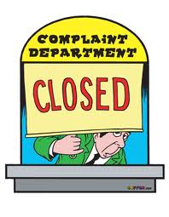
……or at least reduced!

Slide 28
Possible ways to reduce grumbles
Recognize bad behaviors and find ways to address before they become complaints
Assess workplace culture to determine what Grumbles are shared overall
Focus on workplace justice as a means to improve organizational health
Fairness, procedures and reactions
Review training programs, codes of conduct
Promote active Emotional Intelligence activities

Slide 29
References
An Investigation of Maslow’s Need Hierarchy and “grumble” theories, Gail Stansbury Brown, The University of Texas at Austin, 1991
Are You a Metagrumbler?, James Napier, 2007
Emotional Intelligence and the Construction and regulation of feelings, John Mayer and Peter Salovey, Applied & Preventive Psychology, 4:197-208, Cambridge University Press, 1995
Eupsychian Management, A Journal, Abraham Maslow, Dorsey Press,1965
Manager’s Pocket Guide to Emotional Intelligence, Emilty Sterrett, HRD Press, 2000
Maslow on Management, Abraham Maslow, John Wiley and Sons, Inc., 1998

