Slide 1
E-Book Use & Interest Among Students @the University of North Carolina Greensboro
Lea Leininger, Health Sciences Librarian
Beth Filar-Williams, Distance Education Librarian
University Libraries, UNC Greensboro
October 12, 2011

Slide 2
UNC Greensboro University Libraries
The University of North Carolina at Greensboro
Medium-sized research intensive
> 17,000 FTE students
> 1,760 distance education & online students
University Libraries
Jackson Library (main) and Music Library
1.5 million in-person visitors, 5.75 million virtual visits last year
370 databases, 31,000 ft journals

Slide 3
E-Books at the University Libraries
Access to > 331,000 electronic books
More than 30 platforms
Notes:
Mostly html/pdf; no textbook collections, no e-reader loans
Simultaneous user limits – ebooks on Ebscohost, R2 library, myilibrary

Slide 4
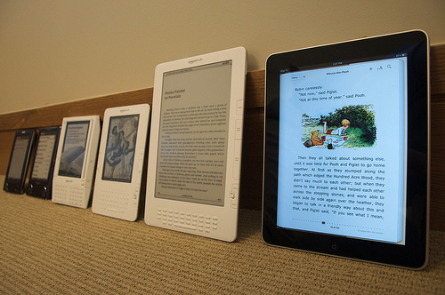
Student E-Book Survey @UNCG
What are students doing with e-books?
Where do the Libraries fit in?
Objectives:
Gain user feedback
Adapt e-book discovery & help
Inform library purchases
http://www.flickr.com/photos/36813960@N00/4505413539/
Notes:
And promote current offerings

Slide 5
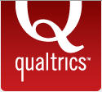
Methods
Six questions, several adapted from a study of undergraduate students at Simmons College ¹
Recipient selection, email, demographics from Office of Institutional Research
Survey built in Qualtrics, link sent to
4,000 UG students (random sample)
3,454 graduate students (all)
MS Excel for sorting qualitative data
1. Hernon P, Hopper R, Leach MR, Saunders LL, Zhang J. E-book Use by Students: Undergraduates in Economics, Literature, and Nursing. The Journal of Academic Librarianship. 2007;33(1):3-13.
Notes:
Other studies that were helpful:
Overview. (n.d.). JISC national e-Books observatory project. http://www.jiscebooksproject.org/overview
Gielen N. Handheld E-Book Readers and Scholarship. American Council of Learned Societies Humanities E-Book; 2010:1-34. http://www.humanitiesebook.org/heb-whitepaper-3.html

Slide 6
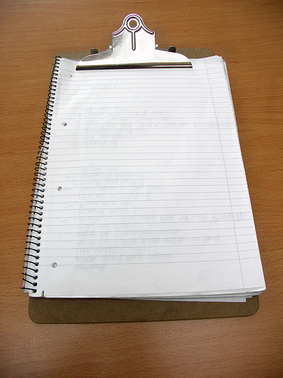
Questions
1. How often do you use ebooks?
Less than Once a Month (or never)
Once a Month
2-3 Times a Month
Once a Week
2-3 Times a Week
Daily
2. Which device(s) do you use to read or use e-books? Any ebook use counts – recreational reading, study, professional development, etc. Check all that apply.
Desktop computer
Laptop computer
Blackberry
Android
iPhone
Tablet such as iPad
Kindle
Nook
Other
http://www.flickr.com/photos/60364452@N00/264892571/
Notes:
Introductory message
Dear UNCG Student,
We want to know what you think of electronic books ("ebooks") !
Have you seen a "Kindle" or another book reader? Maybe you've seen some electronic books in our online catalog.
This brief survey will take you 1-2 minutes to complete and will help us understand how to better serve your needs in the future. All responses are strictly confidential! Thank you! -- The UNCG University Libraries

Slide 7
Questions, cont’d
3. What formats/ebook reading methods are you aware of? Check all that apply.
PDFs
Web pages
Books that can be downloaded to a phone or to a reading device
4. How do you find your ebooks? Check all that apply.
Amazon.com
Barnes and Noble
UNCG University Libraries catalog
Greensboro Public Library
NC LIVE
Google Books
Other

Slide 8
Questions, cont’d
5. How likely are you to use an ebook for the following? Check all that apply.
Browse or scan, looking for information that you need
Use keywords to search for information that you need
Settle in for a nice long read to learn all about a topic
Read brief parts of the text that seemed most pertinent
Download content, when possible
Copy and paste content to MS Word, when possible
Print content
Use publication info to develop bibliographies for your papers
6. Do you have any suggestions or feedback for the library regarding ebooks?

Slide 9
Results-Demographics
440 completed the survey: 5.9% response rate
Notes:
Respondents represented 81 majors. Library and Information Studies students were the largest group of respondents (41).
Majors Found in Academic Branch Categories Above:
Applied sciences= LIS, Counseling, SWK, Pub Affairs, Conflict Res., Rec & Parks, Hosp & Tourism, IAR
Health Sciences=Nursing, Pub Health Ed, Nutrition, Health Ed, HDF, Kin, CSD, Pre-nursing, GCP, Pre-Pub Health Ed, Nano, Professions in Deafness, Speech Pathol & Audiol, Pre-HDF
Humanities=Eng, Hist, Music, Creative Writing, Music Ed, Drama, Classics, Art, Relig, Span, Latin, French
Education=ERM, ELC, Educ Leadership, Special Ed, Educ Studies, Curr & Instruction, Elementary Ed, Higher Ed Admin, Educ, Pre-Elementary Ed, Pre-Special Ed/Elem Ed
Social Sciences=Psyc, Geo, Sociol, WGS, Geron, Anthropol, Poli Sci, Afr Am Studies
Business & Economics=Bus Admin Day, CARS, Bus Admin, Accounting, Finance, Applied Econ, Pre-Bus Admin, Econ, Dual Geron/Bus Admin, Pre-Intl Bus, Pre-Accounting

Slide 10
Results-Frequency of Use
How often do you use ebooks?
54% - Less than once a month or never
11% - Daily

Slide 11
Results-Devices
Which device(s) do you use to read or use e-books? Check all that apply
9% indicated Other – Most common write-in responses were
I don’t use e-books (12)
iPod (8)
Notes:
30 of the respondents wrote in an answer for “Other.” The most common write in responses were
I don’t use e-books (12 times)
iPod (8 times)
Sony E-Reader (3 times)

Slide 12
Results-Discovery Sources
How do you find your ebooks? Check all that apply
61 “Other” sources mentioned. Most common:
Apple - iBooks app (12), iTunes (3)
Other institutions – other public libraries (5), WFU (1)
Notes:
Respondents volunteered 61 “other” sources of e-book content, for instance:
The Apple iBooks app (12), iTunes (3)
“I don’t use e-books” (8)
Other specific institutions - WFU (1), Wake County Public Library (1), Charlotte Mecklenburg Public Library (1), Mebane Public Library (1), Forsyth County Public Library (1), Chatham County Public Library (1)
Project Gutenburg (5)
Informal e-book sharing (5) – “friends,” “Torrents” P2P network, “sharing,” “pirating”
Google Books or Google Scholar (4)
North Carolina Digital Library (3)
Borders (2)

Slide 13
Results-Typical Use
How likely are you to use an ebook for the following? Check all that apply
Notes:
Respondents volunteered 61 “other” sources of e-book content, for instance:
The Apple iBooks app (12), iTunes (3)
“I don’t use e-books” (8)
Other specific institutions - WFU (1), Wake County Public Library (1), Charlotte Mecklenburg Public Library (1), Mebane Public Library (1), Forsyth County Public Library (1), Chatham County Public Library (1)
Project Gutenburg (5)
Informal e-book sharing (5) – “friends,” “Torrents” P2P network, “sharing,” “pirating”
Google Books or Google Scholar (4)
North Carolina Digital Library (3)
Borders (2)

Slide 14
Results-Feedback
121 responses. Examples:
They are great!
So helpful to get the one chapter I'm looking for, rather than trek to the library
Sometimes the index …isn't great but the search in ebooks usually works great
Stick to paper books and make the world a better place
Reading ebooks (is) ruining our eyes
Difficult to highlight and make notes
make them more available
Sometimes, having a copy of a book saved to your computer is invaluable
Ability to carry all the books you need…on one device…brilliant!
Avoid DRM like the plague
I don’t like how they can time out
Publicize which e-book format you most frequently purchase
Not all books transfer well to ebooks
A number of people cannot afford the equipment to use (e-books)
You can easily get distracted
Notes:
121 comments, some up to a paragraph with multiple messages
24 strongly preferred e-books
27 strongly preferred print
10 “middle of the road” – I love ebooks…I still use the hard copies // Keep them but don’t get rid of the print
17 requested content for e-readers
9 requested e-textbooks
3 complaints (one had useful info) –
Most of the e-books I have looked at in the library are worthless. They don't let you download more than a paragraph at a time. / / When i want to use an e-book I go to Gutenburg first. Their books are the easiest to use. You can downloan them, reformat them to the font and word size that suits your need. The books you see in the library are clunky because the provider doesn''t want your experience to be worthwhile. I notice many of them are rip-offs of Gutenburg books. but they screw them up so you can't download anything. Most e-books found in the library are a waste of time and the library's money. Gutenburg's books are the easiest to use, but there may be more books avabilable from Google. It is fairly obvious that none of the librarians ever try to use the e-books presently available in the library. If they did they would all say, "Let's get rid of these clunkers!" / / I would recommend deleting all the e-books that are not downloadabel from the library. They are only e-books because they are out of copywright. Recommend that all students search Gutenburg first, and then Google. They are more satisfactory experiences. / / Why make the results confidential? The e-books in the library suck! They need to be removed. Make it easier to go to Gutenburg and google by making them the first choices to search for an e-book. In order to make a biblioghaphy, you need a real book. Anything else is undependable. If you were to cite on of the e-books in the library, not every library has the same worthless ripoffs. You never know if what you see is the real book. / / A hater of the library's e-books.

Slide 15
Results-feedback, cont’d

Slide 16
outcomes
Library Discovery & Help
Updates to library help pages - more comprehensive list of collections, access and format details in “more info”
Future Library Purchases
Avoid “online only” collection except in specific areas such as Reference
When negotiating, consider patron needs –downloadable, no concurrent user limits/ time outs, variety of formats
Consider e-readers and e-reader lending as academic offerings mature and funding allows
Training for public services staff
Publicity, marketing

Slide 17
Acknowledgements
Lea Leininger <laleinin@uncg.edu> and Beth Filar-Williams <efwilli3@uncg.edu> would like to thank the other members of the E-Book Task Force:
Ms. Christine Fischer, Head of Acquisitions
Mr. Chad Therrien, Web Usability and Library Assessment Analyst
Ms. Beth Bernhardt, Electronic Resources Librarian

