Slide 1
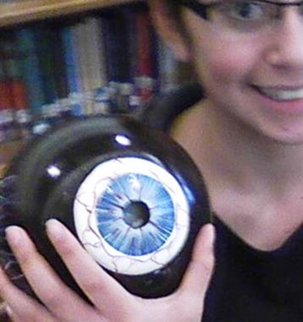
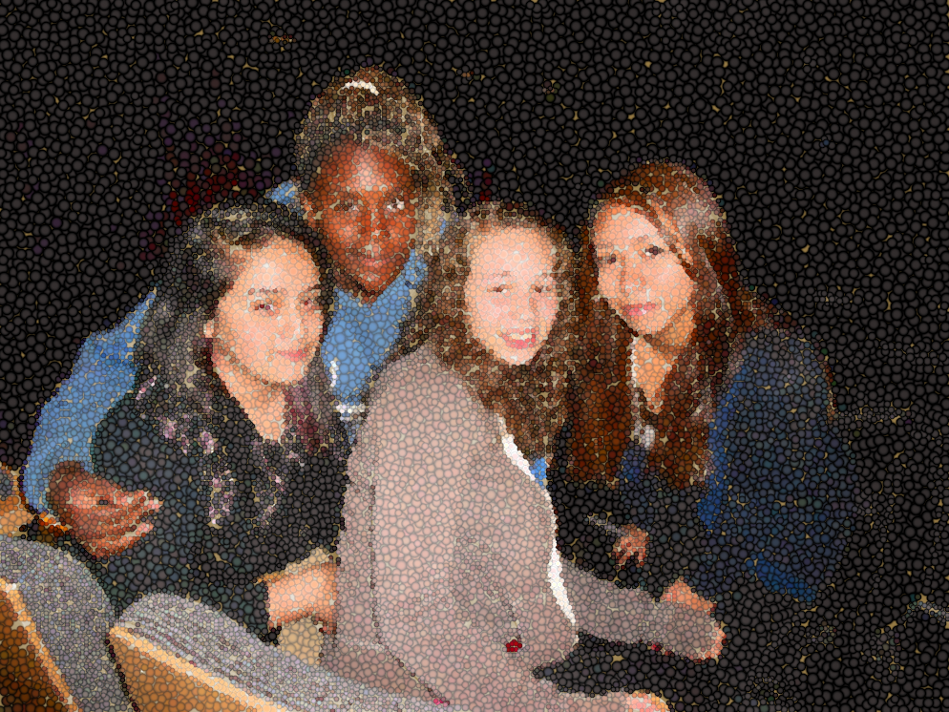
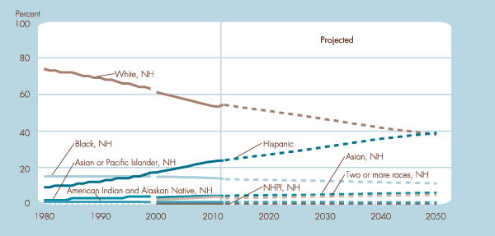
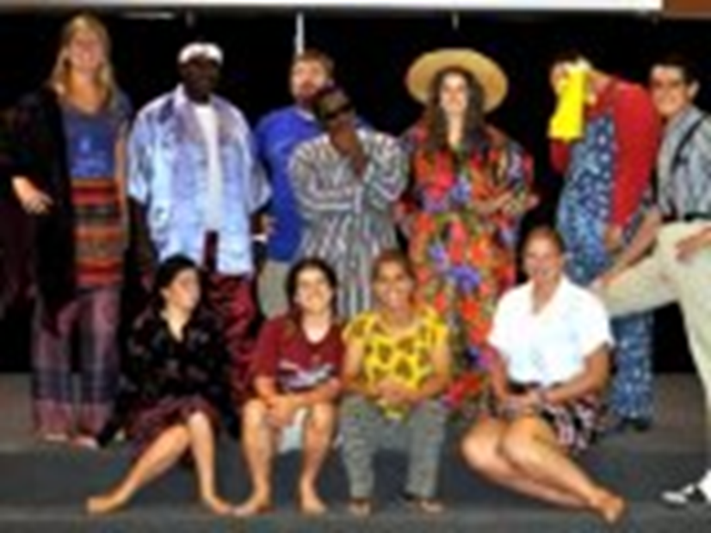
A Socioculturalist Remakes a Middle School Classroom or--
UNPACKING MORE TOOLS FOR LEARNING
Kathryn Kujawski Brown, UNC-G Doctoral Student . Colleen Fairbanks, UNCG Advisor
KATHRYN Find Friends Home
SUMMARY
Schools today can find ways to guide students and teachers to share meaningful experiences. Educators may find it interesting to share student experiences while teaching. These experiences may make teaching and learning things more fun for everyone. We learn four things from this: Children and teachers learn more when they share experiences. When children and teachers use what they know, then students feel better about their classes, their teachers and their schools. Children who feel good about sharing experiences learn more in school. Children who do well in school care about others in BIG ways.
WHAT’S NEXT?
Future studies continue to look for ways for students and teachers to share experiences in the classroom. When educators and students share more, then everyone learns more.
INTRODUCTION
Schools shape children to do great things and connect people to future dreams. So, schools today create leaders for tomorrow who have big jobs to do. Some of these career choices may bring peace to other nations, feed the hungry, give shelter to the homeless and cure diseases we don’t know about today. So schools today serve many diverse people --they build learning communities to learn more about one another and other people.
HYPOTHESIS
How can everyone find a way to share their experiences? How can everyone make learning more interesting in the classroom? I predict— IF everyone shared what they know about something, THEN teachers and students might be able to create better ways of understanding things—like school, each other, and the world.
METHODS
Yet, schools today may find it hard to connect to many different people of many different cultures. One way to help is to re-think how we do school. To find out more, I used my experiences and the experiences of others to answer two questions: How do people like things done in and out of school? 2. How can these experiences help people learn?
+
Friends
Message | All |
Timeline | About | Friends 1,900,000,000 mutual | Photos 15 | More
How can we unpack more tools for learning?
What do we need to do to help all students succeed?
POST
What our friends say…
When I don’t know English, it helps me if someone connects what I already know to the new idea.
Teach me like the best classes.
I have history; It makes me who I am… Will you hear my story?
Teach me more about my people in US History.
.
Like . 47,000,000 Comment . Share . 15 min ago
Like . 3,486 Comment . Share . 37 min ago
Believe I can do what the best students do. Give me a chance to lead and teach.
Will you teach me leadership skills?
PERCENTAGE OF US CHILDREN, 0–17 YRS BY RACE AND HISPANIC ORIGIN, 1980–2011 & PROJECTED 2012–2050
NH means Non-Hispanic
Like . 42,000,000 Comment . Share . 25 min ago
Thank You, UNC—Greensboro! Thank you for care, leadership and financial support while developing this project.
Past financial supports include: Pell Grant, seven UNCG tuition grants, two School of Education General Scholarships and a School of Education summer stipend to continue studies. These generosities mean much to me.
My 14 years as a middle grades teacher taught me to ask questions about how to meet the needs of many students. The work at UNCG helped me understand the urgency of social equity for today, right now, and for all people.
With much gratitude,
Kathryn K Brown
Retrieved 3/24/2013 at US Census Source, http://www.childstats.gov/americaschildren/demo.asp
Why do I feel forgotten and left out?
Teach me to ask why things are the way they are.
Why do I see unfair things happening all over the world?
Teach me how to be just and to help others live their dream, too.
Like . 23,900,000 Comment . Share . 28 min ago
Like . 1,000,000 Comment . Share .48 min ago

