Slide 1
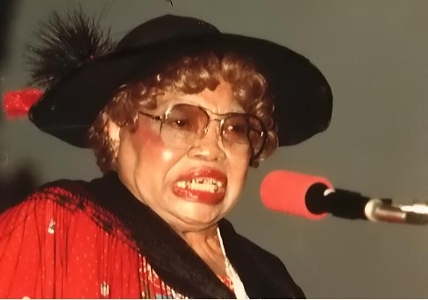
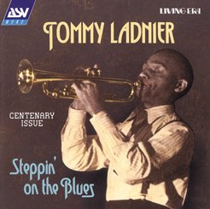
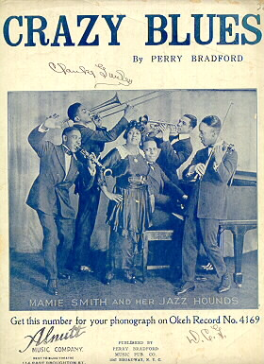
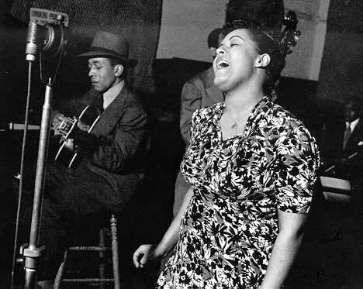

Music
Sippie Wallace
The Most Specialized Humanities Field
Billie Holiday
Mamie Smith
James V. Carmichael, Department of Library and Information Studies University of North Carolina at Greensboro 2010

Slide 2
Subfields
Composition: art of creating music.
Performance: Realization of music in sound and time.
Study of Music.
  Historical musicology.
    Establish texts, attribute scores, document lives, define genres, periods, etc.

Slide 3
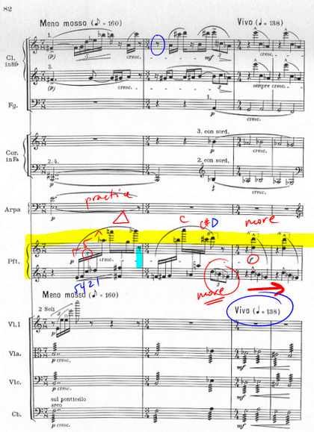
Library Equipment, Materials, Facilities
Scores
  Parts for Orchestration
  Binding
  Miniature scores
Bartok in miniature

Slide 4
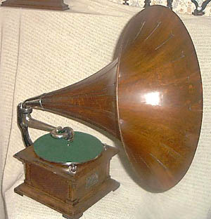
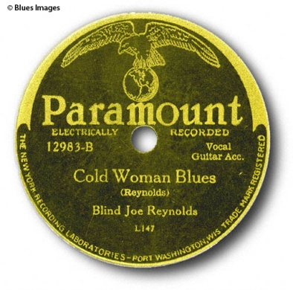
Library Equipment, Materials, Facilities
Recordings
  Variety of formats
  Liner notes and booklets
  Arrangement in library

Slide 5
Library Equipment, Materials, Facilities
Computers
  WWW sites
  RILM
  Instructional/Notation
Instruments
  Historical performance movement

Slide 6
Special Problems
Copier size
Features on equipment
Markings on scores
Microfilming not an option
Need for attentive inventory control
(ILL not usually an option)

Slide 7
Special Opportunities
Performance of original unique scores
New Areas (Popular music, 20th century music, ethnic music, early music)

Slide 8
Areas of Study
Criticism
Music Theory
Ethnomusicology
Systematic musicology

Slide 9
Users and Needs
Composers
Performers
Musicologists

Slide 10
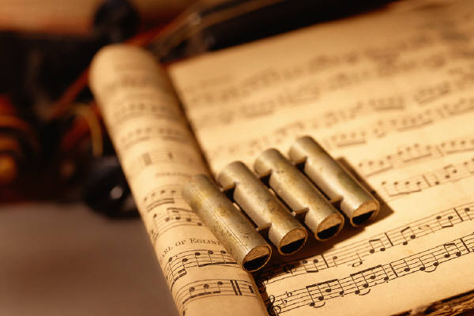
Cataloging and Classification
Both DDC & LC separate scores from writings on music

Slide 11
Library of Congress
ML=Literature of Music
MT=Music Instruction & Study
M Divided into misc.collections, instrumental and vocal music
ML subdivided type or form of book, hist. & crit., philosophy and physics of music
MT divided into music theory, techniques, and pedagogical subdivisions

Slide 12
LC Subject Heads
Works of music by instrumentation, but form takes precedence over instrumentation
Really a contradiction to the LC Classification scheme, where form takes precedence over instrumentation
  Ex: book on sonata form=sonata
  Music in sonata form=sonatas
  Book about Gregorian Chant= Chants(Plain, Gregorian, etc.)

Slide 13
AACR2
Follows version composer used for name
Ex. Beethoven’s Moonlight Sonata
a.k.a. Mondishenisonate
Could also be: Sonata quasiuna fantasia per il clavicembalo o pianoforte, Opera 27, No. 2
Also note importance of musical bibliography

