Slide 1
The Male Librarian and the Feminine Image
Stereotypes and Reality
Carmichael, James V. “The Male Librarian and the Feminine Image: Stereotypes and Reality:” Women, Libraries, and Technology Conference, Universidad de Salamanca, Salamanca, Spain, 29 October 2007.

Slide 2
“The Stereotype”: Does it Exist?

Slide 3
Do Librarians All Have Cats?

Slide 4
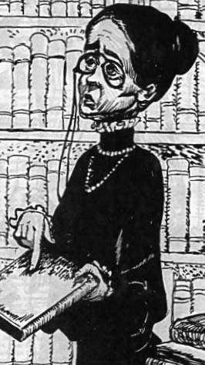
c. 1895-c.1969

Slide 5
Reality: Worse?
Frances Newman, 1887-1928
Librarian, 1912-1925
Dead Lovers Are
Faithful Lovers, 1928

Slide 6
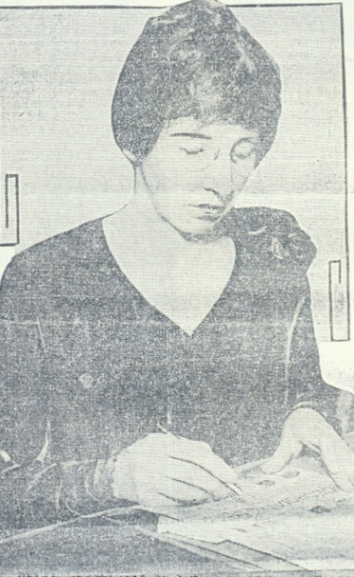
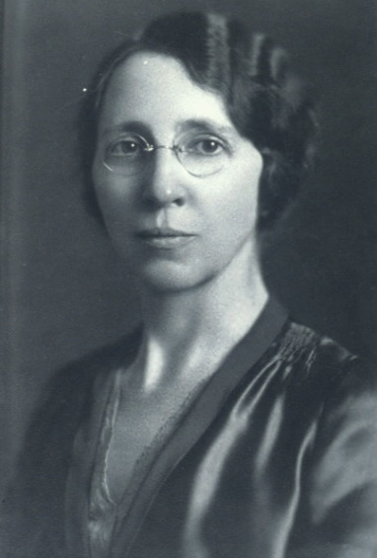
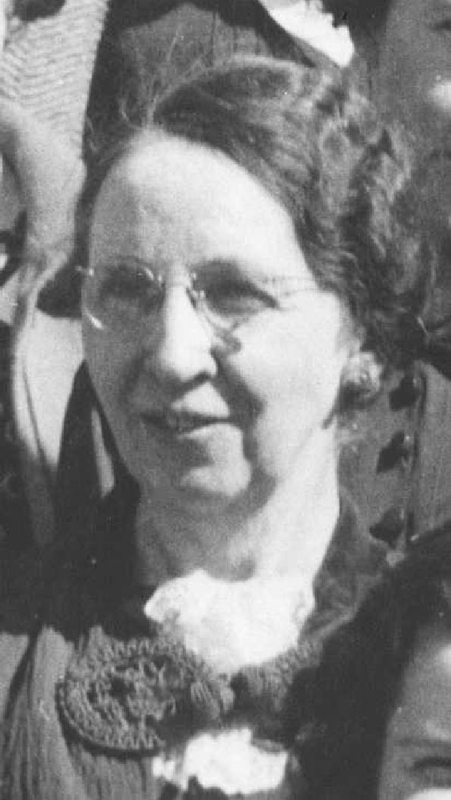
Librarian
Tommie Dora Barker, 1889-1978

Slide 7
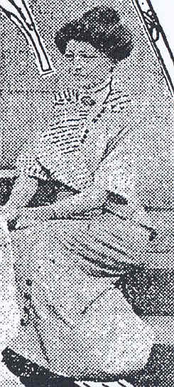
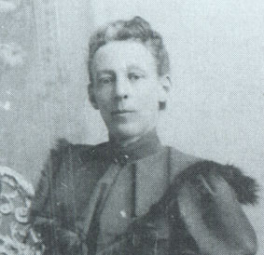
Library Educator
Salome Cutler Fairchild,
1855-1921
Delia Foreacre Sneed,
1871-1947

Slide 8
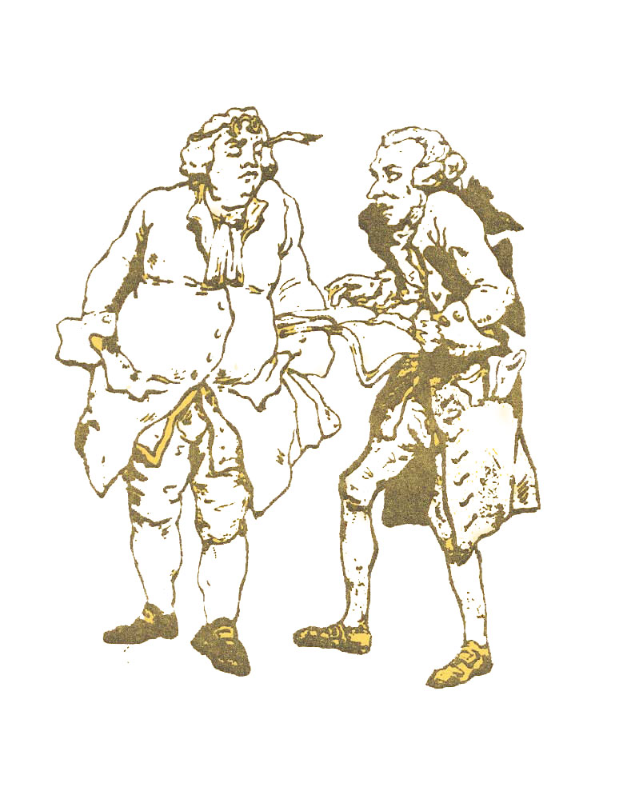
What About Males?

Slide 9
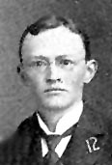
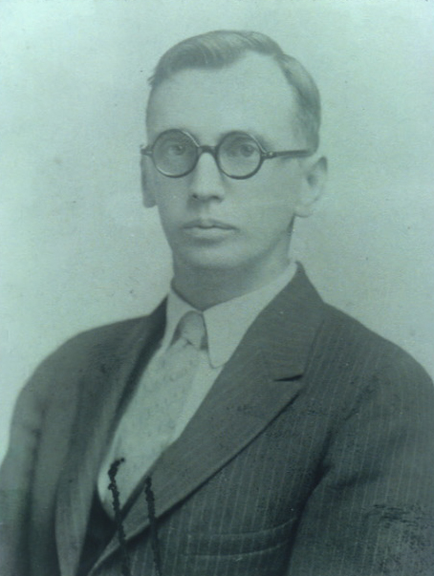
What About Males?
Charles H. Stone,
1890-1965
James I. Wyer,
1869-1955

Slide 10
The Male Librarian Survey
Who are they?
Is there a male stereotype?
What is the Stereotype?
Where does it come from?
Has technology improved it?

Slide 11
The Sample
From ALA Membership Directory
N=482 (73.58%) response rate
Gay males=
44 (9.17%)
Academic=49%
Public=30%
Special=10%
School=5%
LIS=3%
Vendor=1%
Other 1%

Slide 12
The Male Librarian Stereotype
Exists 60%
Origin?
Workplace 26%
Library school 25%
Casual acquaintances 21%
Based in reality?
False 37%
Effeminate,
Probably Gay 82%
Powerless,
Socially inept 59%
Unable to succeed in “real “world 55%

Slide 13
Technology
Has altered stereotype 32%
Has not affected it 30%
Has improved image 84%
Has worsened image 2%

Slide 14
Other Aspects of the Survey
54 % of sample are administrators
45% of respondents say men have no advantage in advancement
Approximately 80% of librarians are female

Slide 15
Sexual Harassment and Discrimination?
No 81%
Yes, discrimination 9%
Yes, Harassment 4%
Sources of discrimination and harassment
Female 56%
Male 11%
Female and Male 30%

Slide 16
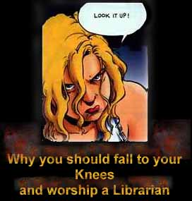
So Now What?

Slide 17
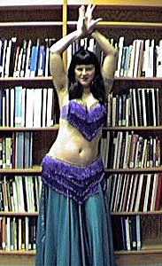
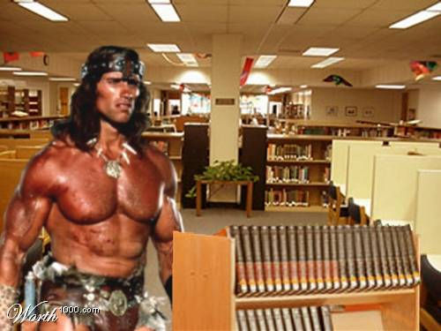
Impact of Sexual Liberation Movement(s)

Slide 18
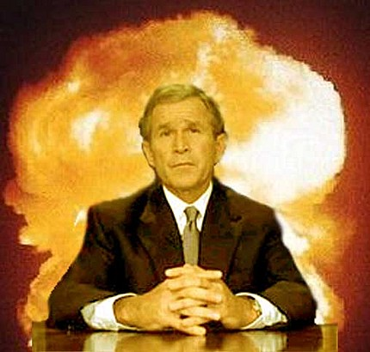
How Important Are Gender Issues to “the World?”

Slide 19
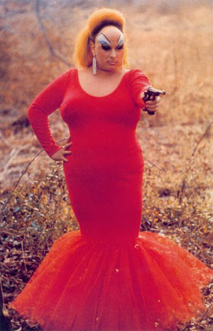
Even Sex is Mutable!

Slide 20
Perhaps the Stereotype is Not So Bad, After All?

