Slide 1
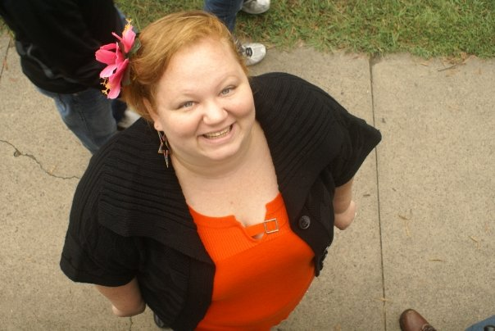
Toolkit Tools Series: Twitter in 30 minutes
Beth Filar Williams, Coordinator of Library Services for Online &Distance Education
Liane Elias, Graduate Student in Library & Information Studies at UNCG
Cheryl Cross, Library Technology Support Analyst
Presented by UNCG Libraries, 10/21/11

Slide 3
POLL: do you tweet?
I have an account & tweet on occasion
I have an account… I think?
Haven’t joined up yet, convince me!
Um, what’s a tweet?

Slide 4
What is Twitter?
….an real-time information network made up of 140-character messages called Tweets
http://dictionary.reference.com/browse/twitter

Slide 5
Twitter History /Stats
Created in March 2006 – launched in July
Company based in San Francisco
200 million users as of 2011
200 million tweets
over 1.6 billion search queries/day
http://dictionary.reference.com/browse/twitter

Slide 6
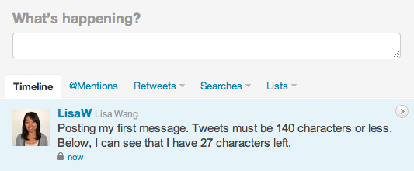
Images from Twitter.com help pages

Slide 8
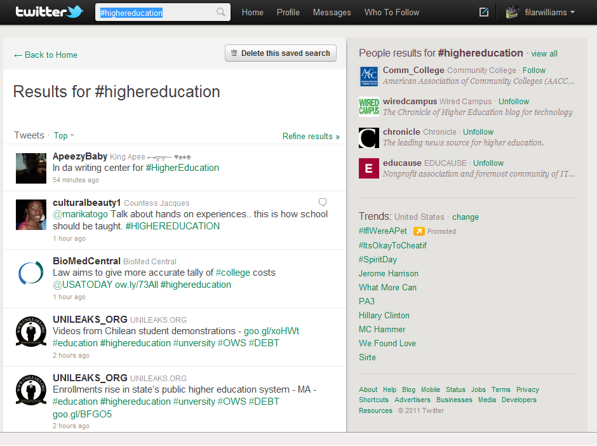

Slide 10
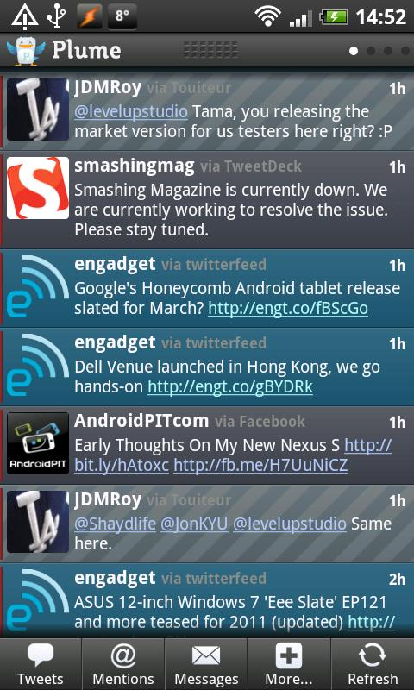
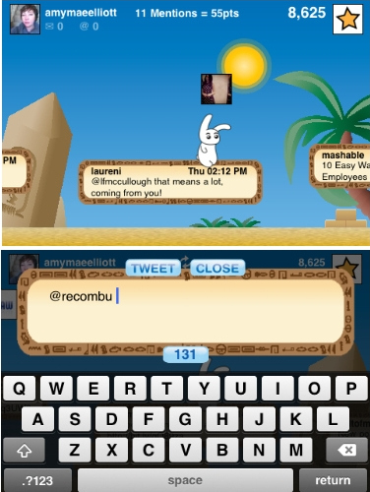
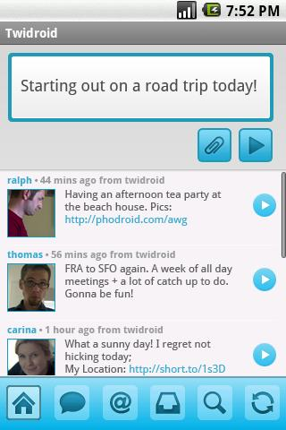
Mobile Options

Slide 11
Twitter usage?
Pointless babble – 40% Conversational – 38% Pass-along value – 9% Self-promotion – 6% Spam – 4% News – 4%
http://www.pearanalytics.com/blog/wp-content/uploads/2010/05/Twitter-Study-August-2009.pdf

Slide 12
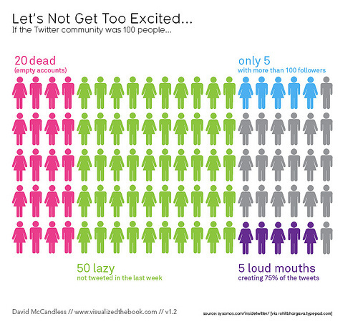
Twitter usage con’t
http://www.pearanalytics.com/blog/wp-content/uploads/2010/05/Twitter-Study-August-2009.pdf

Slide 13
http://www.facultyfocus.com/free-reports/twitter-in-higher-education-2010-usage-habits-and-trends-of-todays-college-faculty/

Slide 14
Special Report: Twitter in Higher Education 2010:Usage Habits and Trends of Today’s College?
How familiar are you with Twitter
http://www.facultyfocus.com/free-reports/twitter-in-higher-education-2010-usage-habits-and-trends-of-todays-college-faculty/

Slide 15
…as a networking and professional development tool
Twitter has been a tremendously useful tool for me in connecting with other professors, discovering new sources and new information, teaching students about some of the dynamics of not just Twitter but real-time information sharing, and for building and continuing relationships made in real life.
It's great to be able to send a quick thought to everyone & receive reactions and connect with so many people at once--family, friends, and friends-to-be.
I've reached more people and have had more exposure as an academic tweeting and blogging about higher ed than I have ever with my more tradition research and publishing.

Slide 16
Twitter in Academia
Class Chatter/Classroom Community
Get a Sense of the World
Track a Word (#awordtofollow)
Track a Conference (#aconferencename)
Instant Feedback
Follow professionals (http://listorious.com/andrewcallahan/academics)
Grammar, rule based writing, writing assignments
Public notepad
From: http://academhack.outsidethetext.com/home/2008/twitter-for-academia/

Slide 17
POLL: Will you try Twitter now?
Already using it but now I will more effectively
Yes!
Maybe
Still not convinced it’s for me.

Slide 18
Q &A?
http://library.uncg.edu/info/depts/reference/instruction/Collaborate/twitter.aspx
Beth Filar Williams, DE Librarian, efwilli3@uncg.edu
Liane Elias, LIS Grad Student, leelias@uncg.edu

