Slide 1
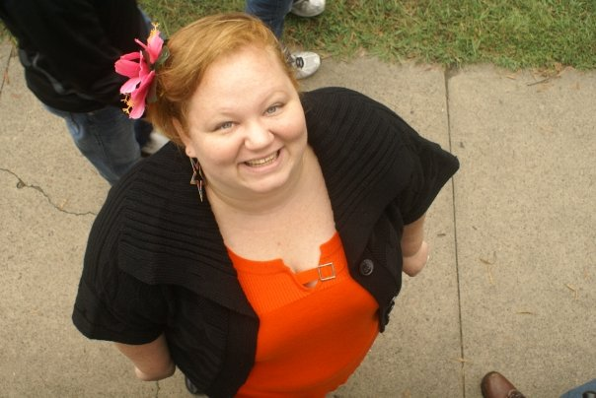
Scholarly Management: Staying Current with your Research
Beth Filar Williams, Coordinator of Library Services for Online &Distance Education
Liane Elias, Graduate Student in Library & Information Studies at UNCG
Cheryl Cross, Library Technology Support Analyst
Presented by UNCG Libraries, 9/28/11

Slide 3
Objectives
to demonstrate various methods for staying current with your research
to showcase the Current Awareness Libguides resources which will assist participants after this session

Slide 4
Types of Alerts/Staying Current
Table of Contents Alerts
Search Alert
Citation Alert
Blogs
Twitter
Google News Alerts
Google Scholar Alerts
Mobile Options

Slide 5
POLL: RSS
I follow RSS feeds, via my email
I follow RSS feeds, via a reader (ex: google reader)
I have heard of RSS but don’t think I follow it?
RSSwhat?!

Slide 6
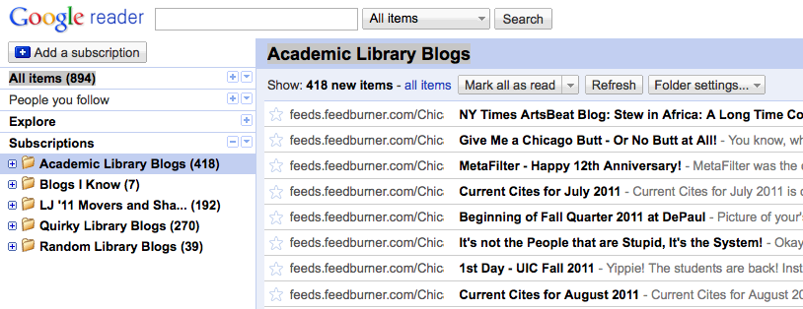
RSS
Stands for Really Simple Syndication
Very simple and streamlined way to bring your news to you
Google Reader is most popular; runs from internet browser

Slide 7
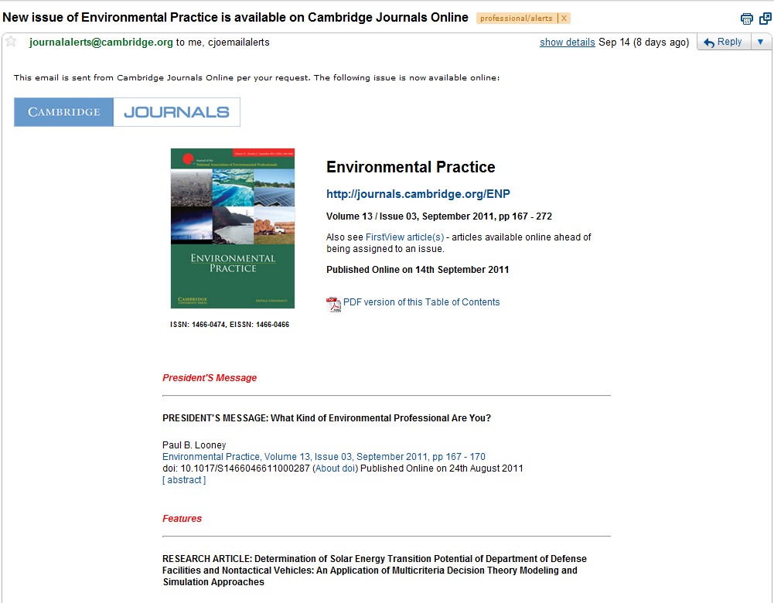
Table of Content Alerts:
Automatically receive a journals latest TOC
Skim article titles, link to full text
Offered by most databases & journals
Delivered via email or RSS feeds

Slide 9
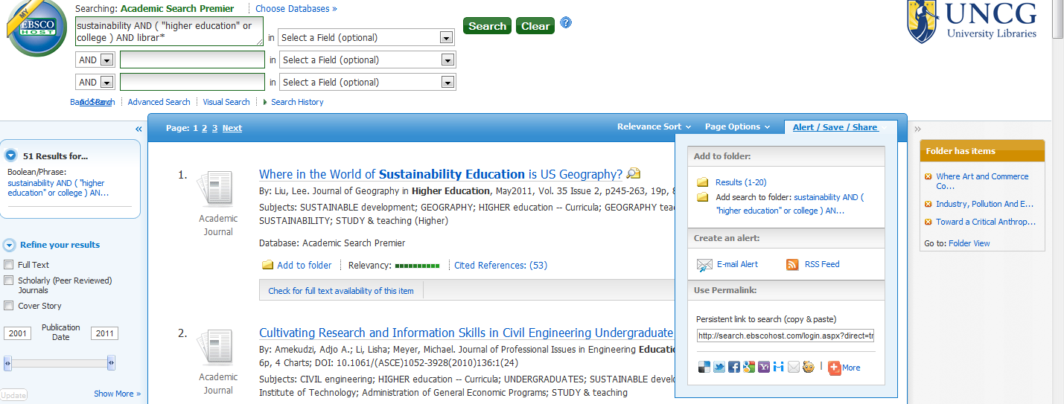
Search Alerts
Set up alert on specific word/phrase in a database
Automatically receive alert when a new article is added
Offered by most databases & journals
Delivered via email or RSS feeds

Slide 10
Citation Alerts:
Create an alert of a particular work
When this article is cited by another article, receive an alert
Offered by only a few database like Web of Science
Delivered via email or RSS feeds

Slide 11
POLL: Blogs
I follow blogs - though mainly for fun!
I follow academic, scholarly blogs (maybe some fun ones too)
I am a scholarly blogger
(A or B) and C
None of the above

Slide 12
POLL: Twitter
I tweet on twitter regularly but mainly for fun
I lurk on twitter but rarely tweet
I use twitter for scholarly purposes only
I use twitter for fun, scholarly purposes and more!
Tweeting is for the birds

Slide 13
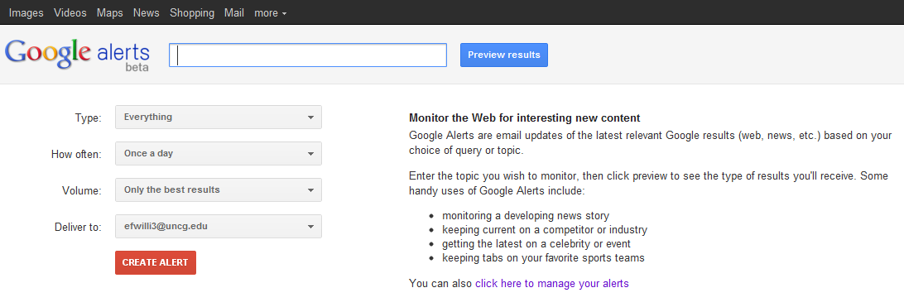
Google News Alerts
http://www.google.com/alerts

Slide 14
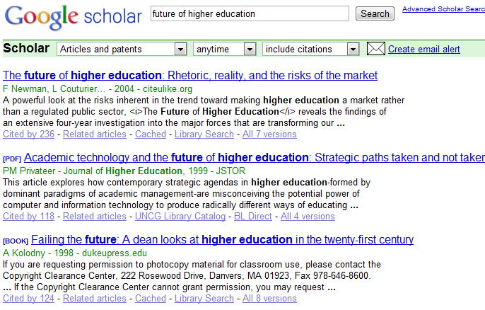
Google Scholar Alerts
http://scholar.google.com/

Slide 15
Mobile Possibilities
Keep up on the go with a smartphone or tablet
Most RSS readers sync with Google Reader
Find one that works for you!
 | iOS | Android | BlackberryOS
RSS Feeds | Reeder($), Mobile RSS, Pulse | FeedR($), gReader, Pulse | Viigo, Arr!SS, Google Reader
Twitter | Twitter, TweetDeck, Super Twario | Twitter, Plume, TweetDeck | Twitter, UberSocial, Viigo

Slide 16
Q &A?
http://uncg.libguides.com/currentawareness
Beth Filar Williams, DE Librarian, efwilli3@uncg.edu
Liane Elias, LIS Grad Student, leelias@uncg.edu

