Slide 1
Libraries for Sustainability
Exploring sustainability in professional organizations
Webinar Series 2012
Webinar 3 of 4
June 12, 2012

Slide 2
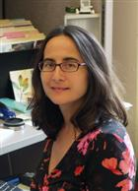
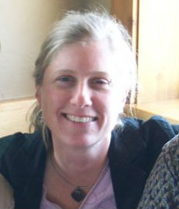
Series Facilitators
Madeleine Charney
Umass Amherst Library
Beth Filar Williams
UNC Greensboro Libraries

Slide 3
Agenda
10-15 minutes
Welcome
Recap of previous webinars
Introduce our webinar #3 facilitators
30 minutes: 2 options
Main Room: discussion on who to engage with profession library groups and orgs
ALA/TFOE Breakout room: discuss future of TFOE
10-15 minutes
Breakroom group returns & reports
Main room reports
Wrap up/action steps.

Slide 4
Recap of Past Webinars
Libraries for Sustainability Webinar Series: Call to Action and Collaboration
Feb 28, 2012
Libraries for Sustainability Webinar Series: Exploring Sustainability Practices in Libraries
April 24, 2012
Libraries for Sustainability Webinar Series 2012
Webinar #3 – June 12, 2012

Slide 5
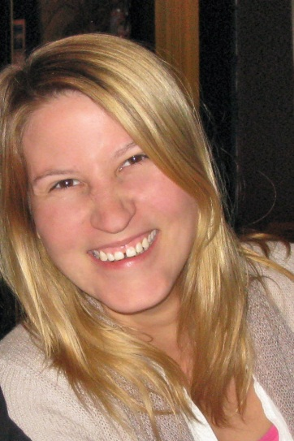
Embedded Facilitators
Hannah Winkler, Earth Sciences Librarian at Stanford University, local member and library representative for the Association for Environmental Studies and Sciences and upcoming TFOE co-chair 2012-2013.
Ashley Jones, Preservation Librarian, Miami University Libraries, and upcomingTFOE co-chair 2012-2013.
Libraries for Sustainability Webinar Series 2012
Webinar #3 – June 12, 2012

Slide 6
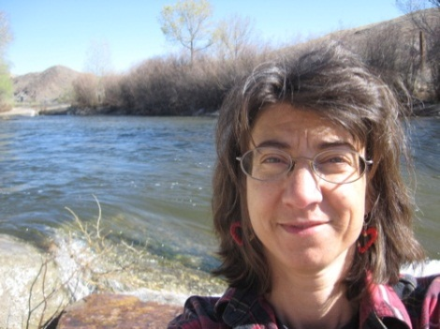
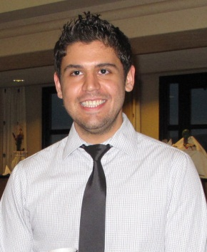
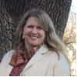
Embedded Facilitators
Evi Klett, Denver Public Libraries – active member of the Transition Towns movement which supports and trains communities to self-organize, build resilience and reduce CO2 emissions.
George Aulisio, Scranton University, Public Services Librarian – Chair of his library's Green Team and member of the University's Task Force on Sustainability.
Mara Egherman, Central College, Collection Development – active member of Iowa Library Association and presenter on green topics.
Libraries for Sustainability Webinar Series 2012
Webinatr#3 June 12, 2012

Slide 7
30 minute Discussion Time!
If you are interested in TFOE group discussion, please move yourself into the breakout room called ALA/TFOE listed in the “participants window”
Move yourself by dragging and dropping your name listed in the participant window into the ALA/TFOE room.
Libraries for Sustainability Webinar Series 2012
Webinar #3 – June 12, 2012

Slide 8
SHARING!
Lets hear from the ALA group & then Main Room!
Libraries for Sustainability Webinar Series 2012
Webinar #3 – June 12, 2012

Slide 9
Next Webinar…
AUGUST 28, 2-3pm(eastern) –>
wrap up series, action plans, next steps
*if you going to ALA, join us Fri June 22 7:30 for TFOE meeting!*
http://ala12.scheduler.ala.org/node/539
Thanks for participating!
Libraries for Sustainability Webinar Series 2012
Webinar #3 – June 12, 2012

