Slide 1
Diving In and Learning to Swim as a New Distance Education Librarian
Rachel Cannady
Britt Fagerheim
Beth Filar Williams
Heidi Steiner
#divingIn
American Library Association Annual Conference
Anaheim, California • June 24, 2012
Notes:
Am building this as a shell based entirely on our outline. If ya’ll want more pages for your sections beyond on each header—you’ll need to let me know exactly what you want and if you want bullets, images, etc.

Slide 2
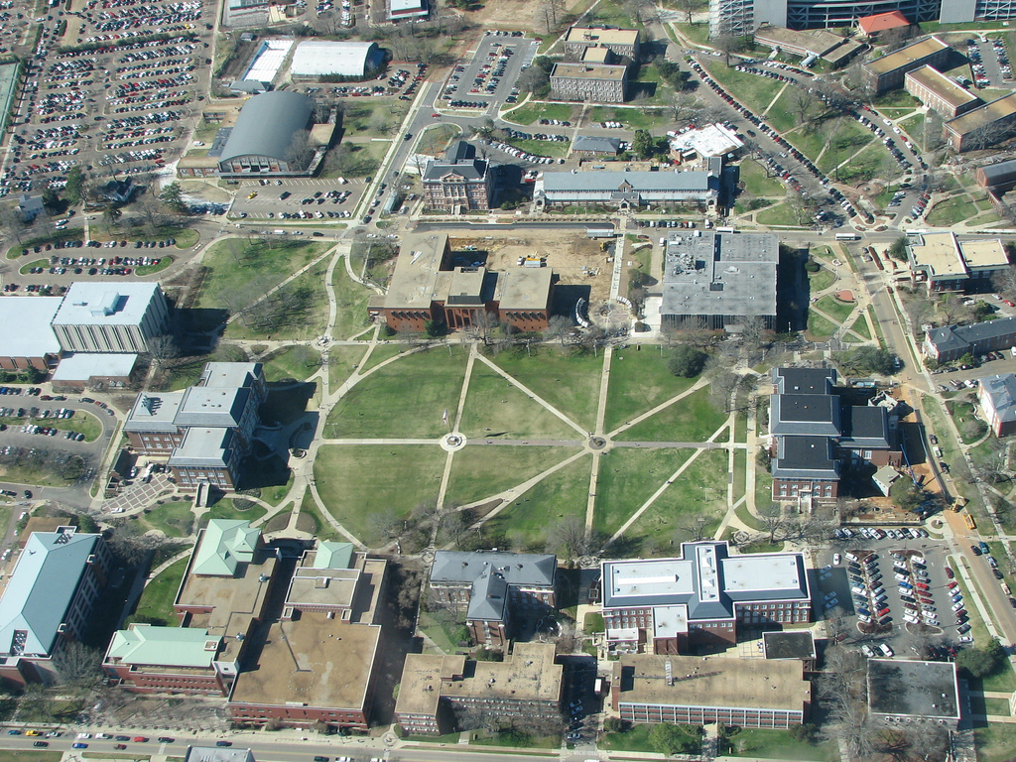
Rachel
Mississippi State University
Notes:
Thinking scenic shots of our campuses/cities

Slide 3
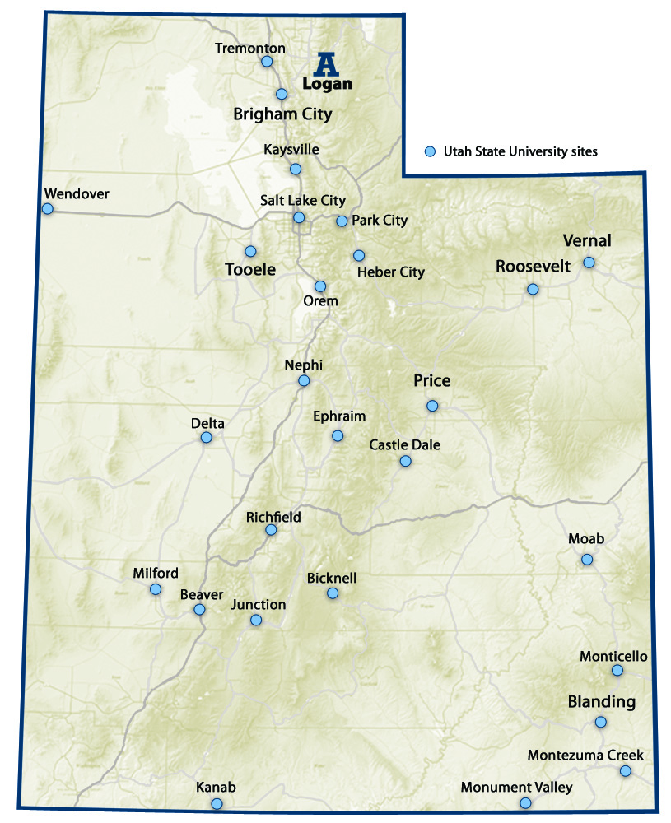
Britt
Utah State University

Slide 4
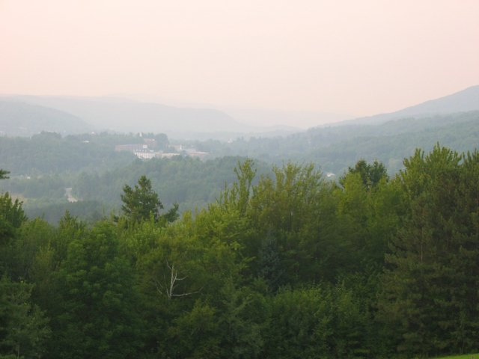
Heidi
Norwich University

Slide 5
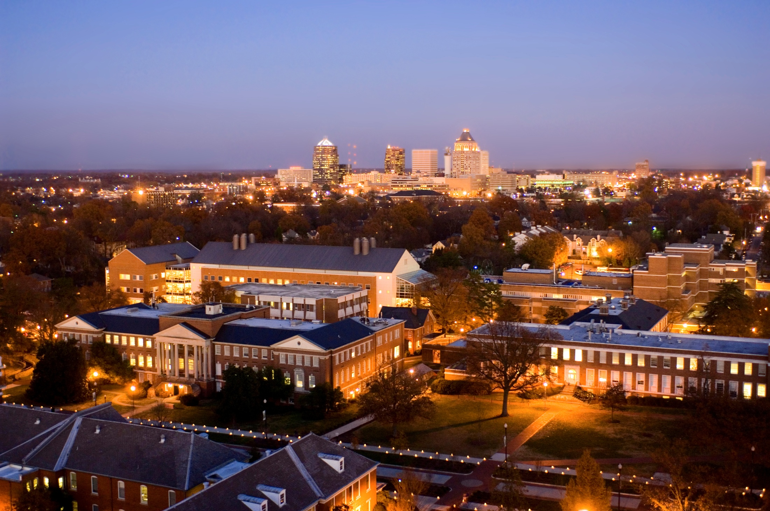
Beth
University of North Carolina - Greensboro

Slide 6
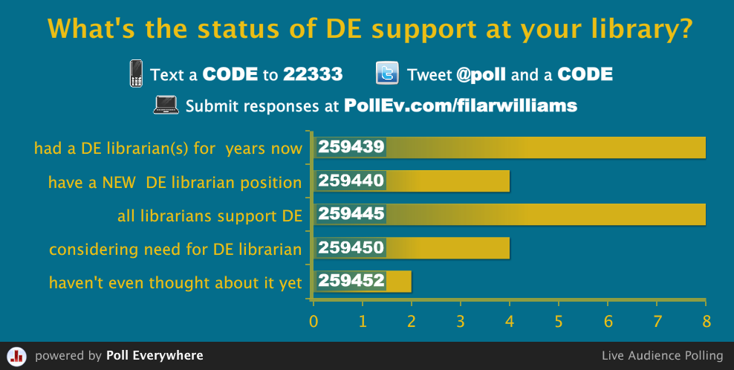
Notes:
Press F5 or enter presentation mode to view the poll In an emergency during your presentation, if the poll isn't showing, navigate to this link in your web browser: http://www.polleverywhere.com/multiple_choice_polls/NDExNTQ3MzMz
If you like, you can use this slide as a template for your own voting slides. You might use a slide like this if you feel your audience would benefit from the picture showing a text message on a phone.

Slide 7
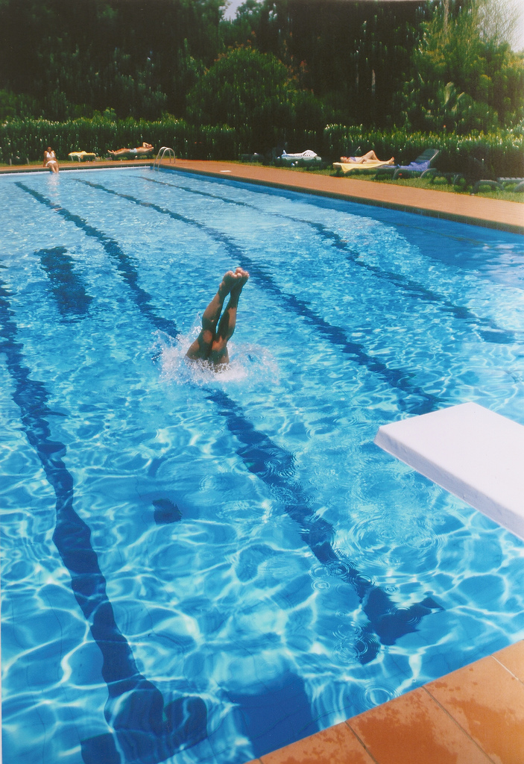
Tips from the Diving Board

Slide 8
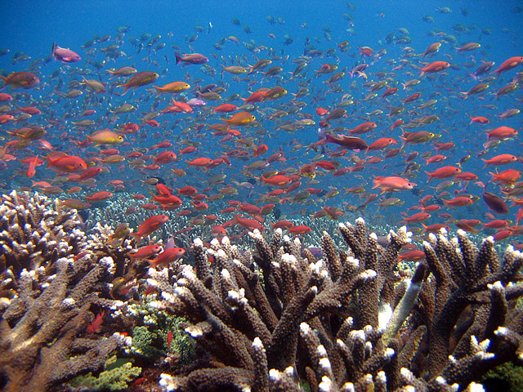
Create a Relay Team

Slide 9
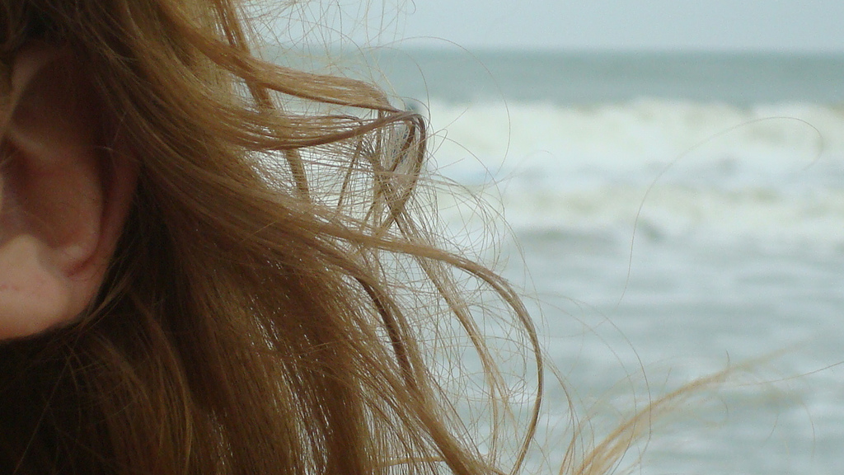
Listen

Slide 10
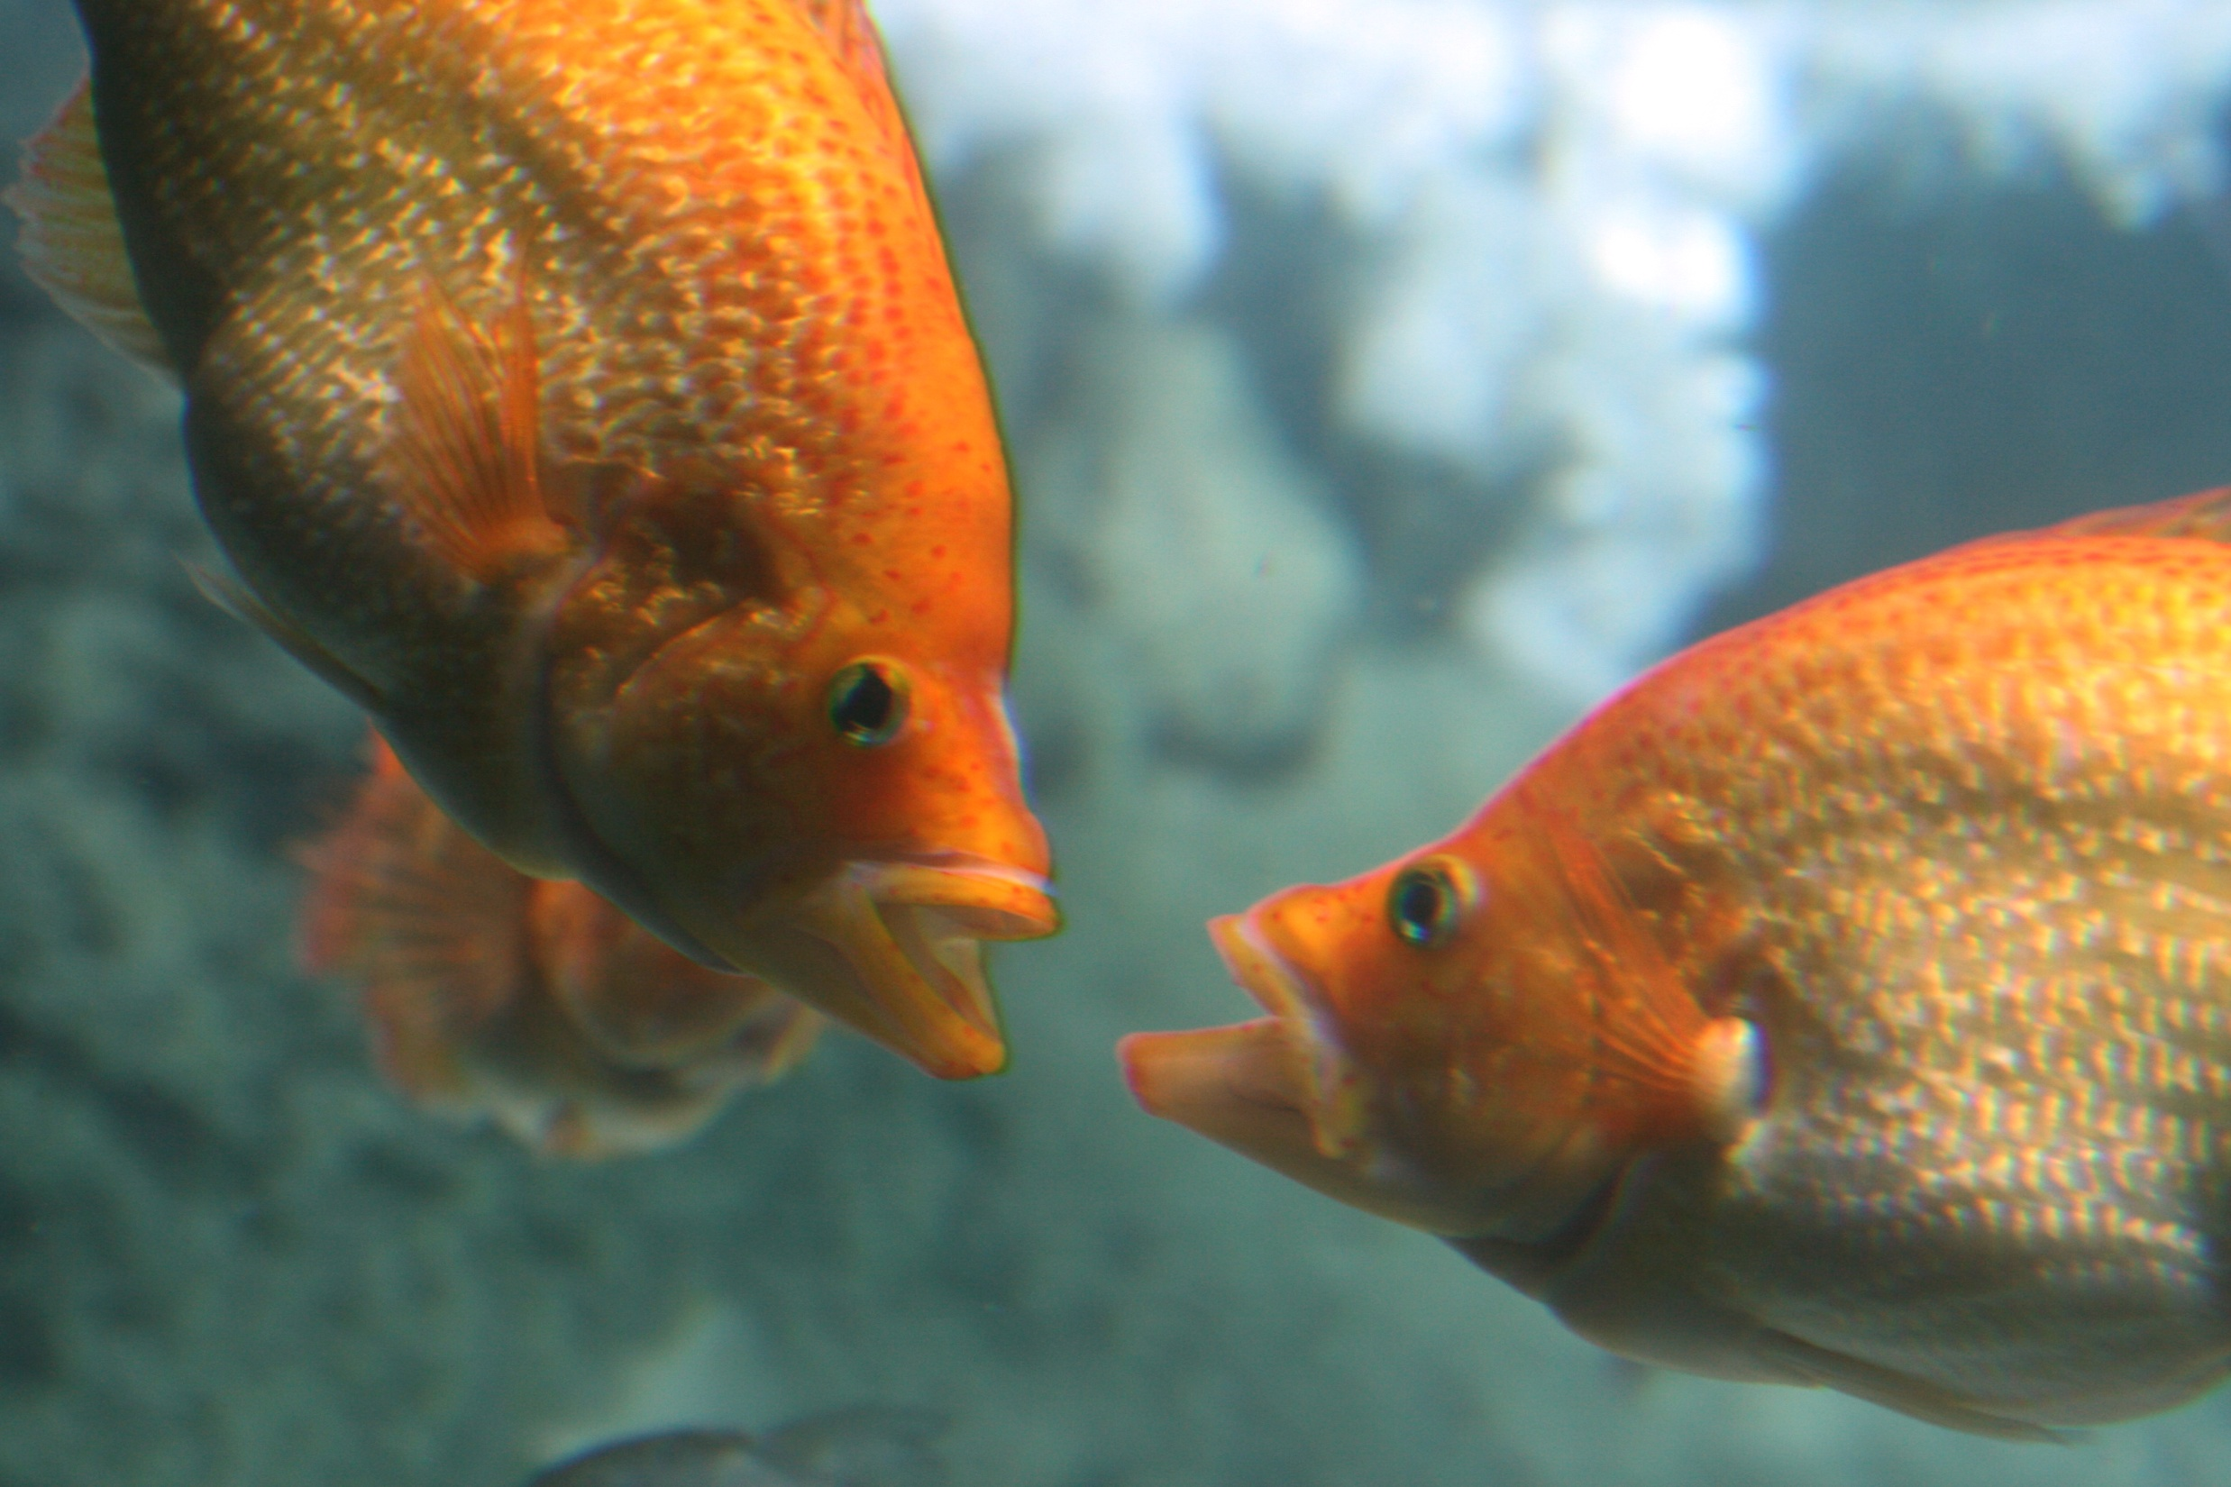
Build Relationships

Slide 11
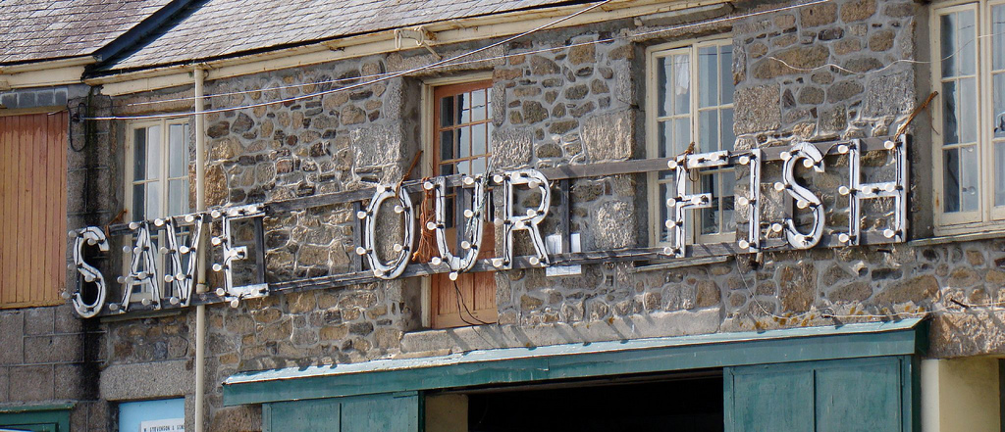
Advocate

Slide 12
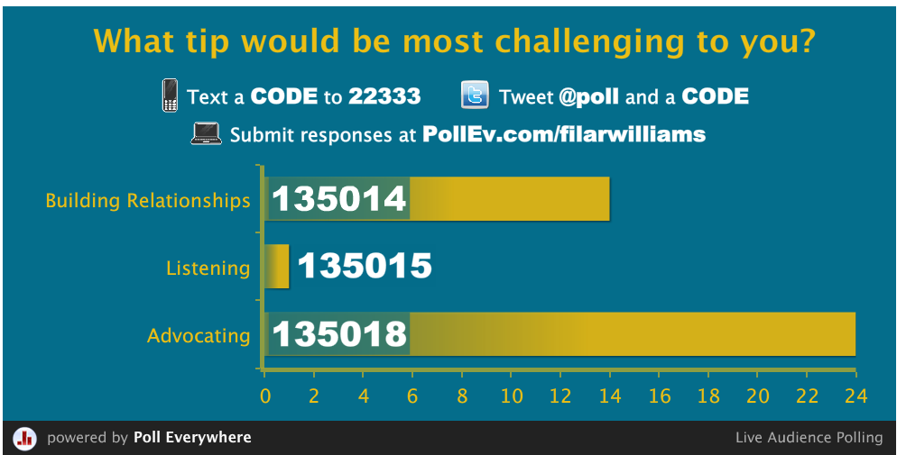
Notes:
Press F5 or enter presentation mode to view the poll In an emergency during your presentation, if the poll isn't showing, navigate to this link in your web browser: http://www.polleverywhere.com/multiple_choice_polls/NTczNzEwMTM5
If you like, you can use this slide as a template for your own voting slides. You might use a slide like this if you feel your audience would benefit from the picture showing a text message on a phone.

Slide 13
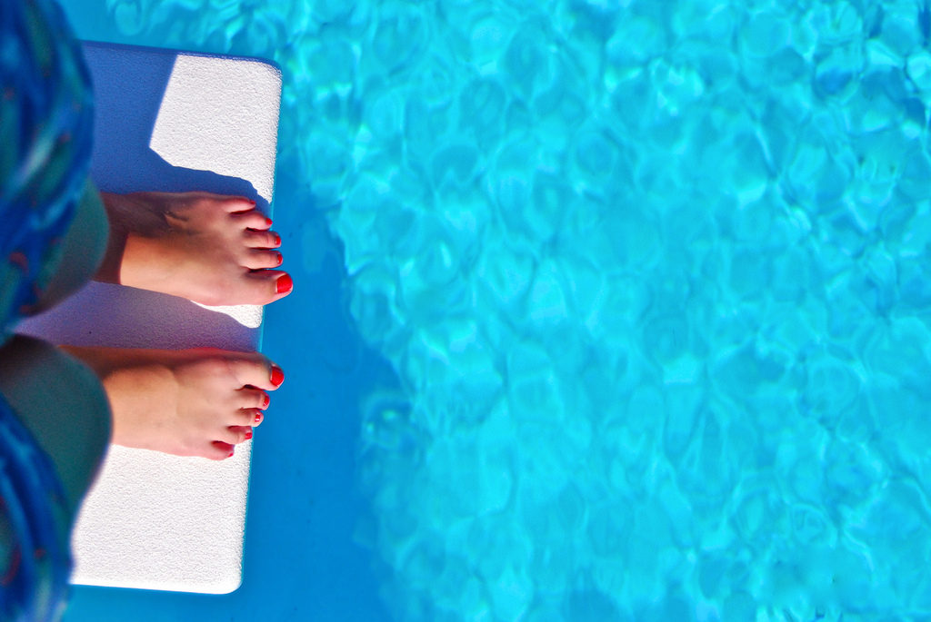
Be Brave. Dive In!!

Slide 14
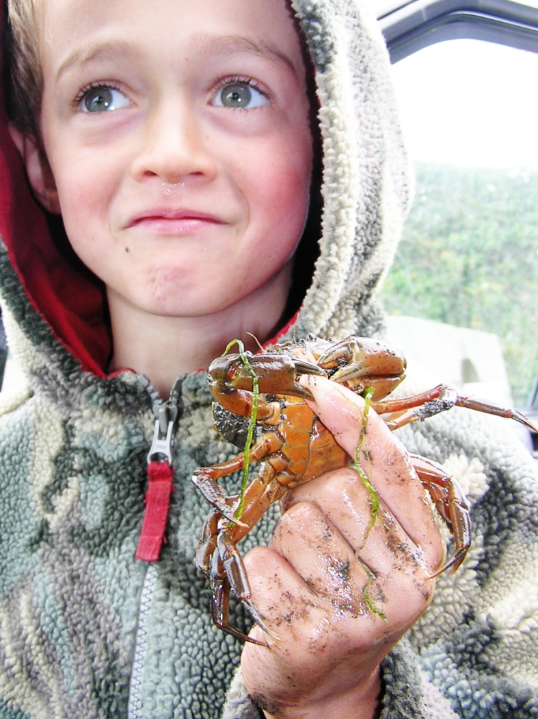
Take Risks

Slide 15
Start small
Document what you are doing and why
Comfort zones

Slide 16
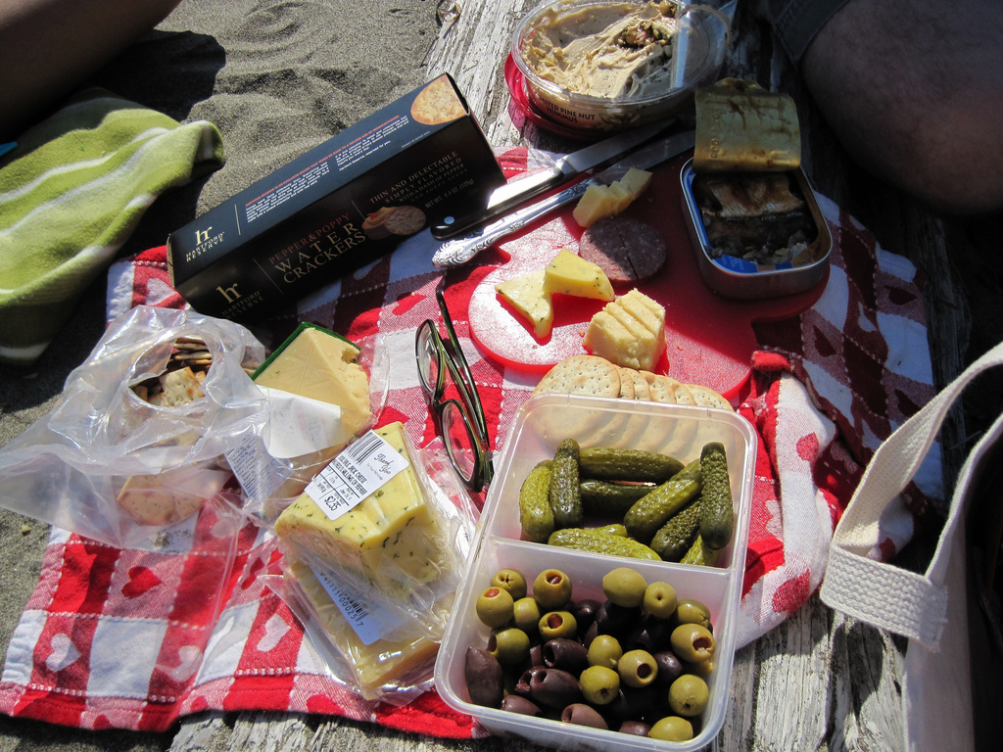
Improvise

Slide 17
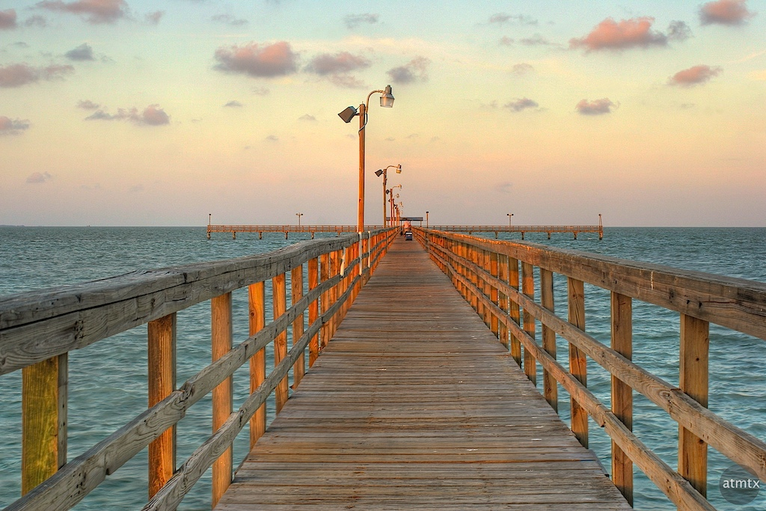
Perpetual beta

Slide 18
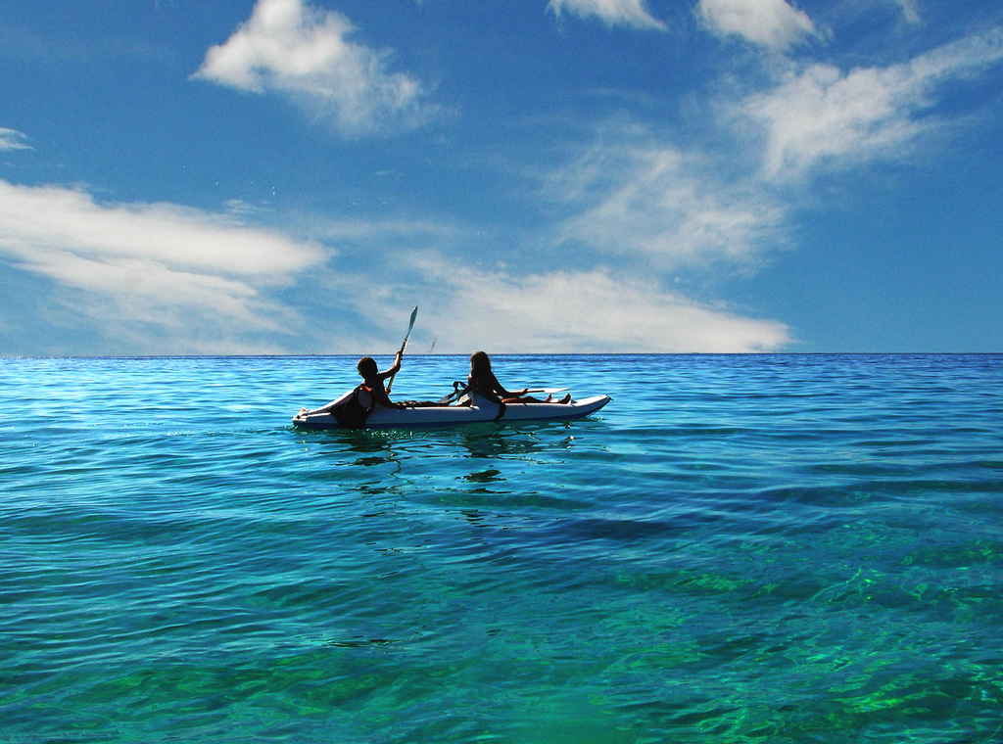
Collaborate

Slide 19
Who?
How?
Why?

Slide 20
Notes:
Press F5 or enter presentation mode to view the poll In an emergency during your presentation, if the poll isn't showing, navigate to this link in your web browser: http://www.polleverywhere.com/free_text_polls/MTE3ODQ0OTU2
If you like, you can use this slide as a template for your own voting slides. You might use a slide like this if you feel your audience would benefit from the picture showing a text message on a phone.

Slide 21
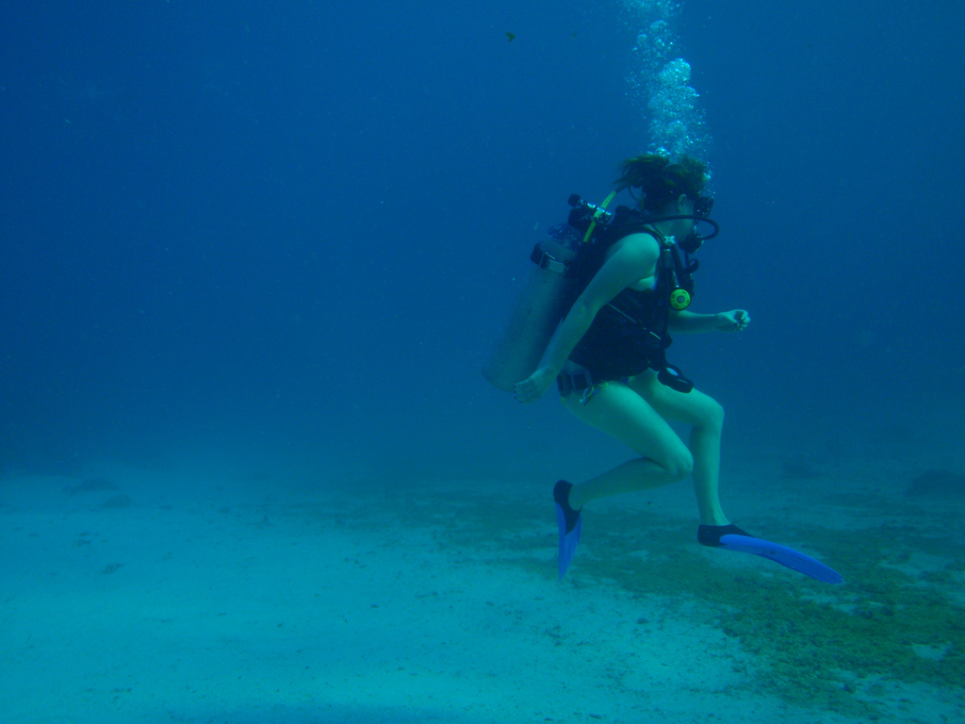
Plunge Into the Deep

Slide 22
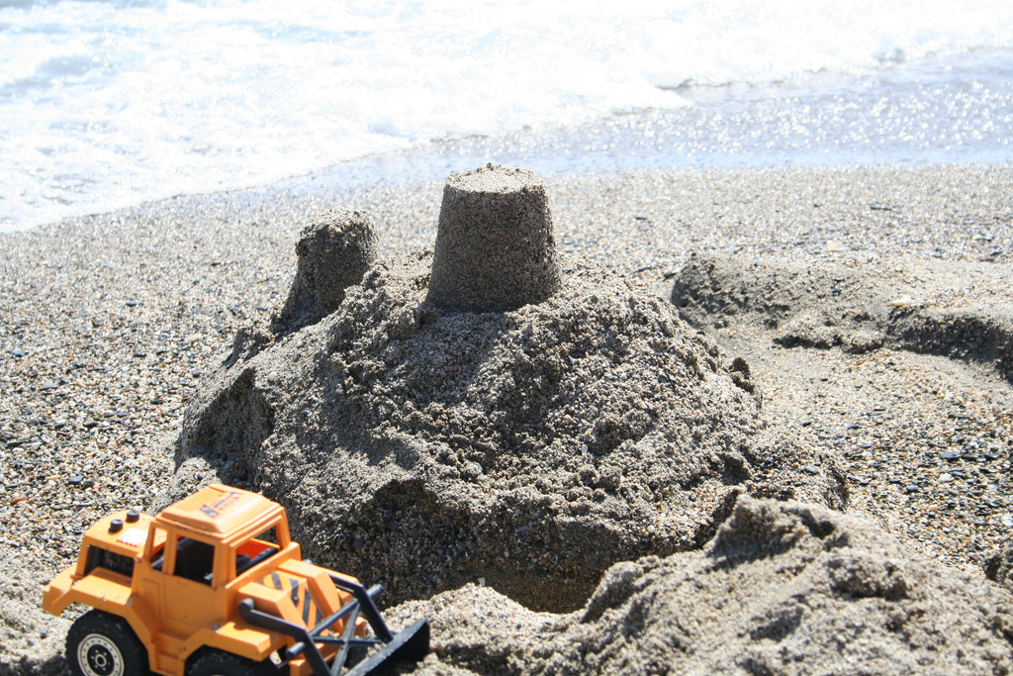
Plan

Slide 23
Patrons
Library
University
Professional Standards

Slide 24
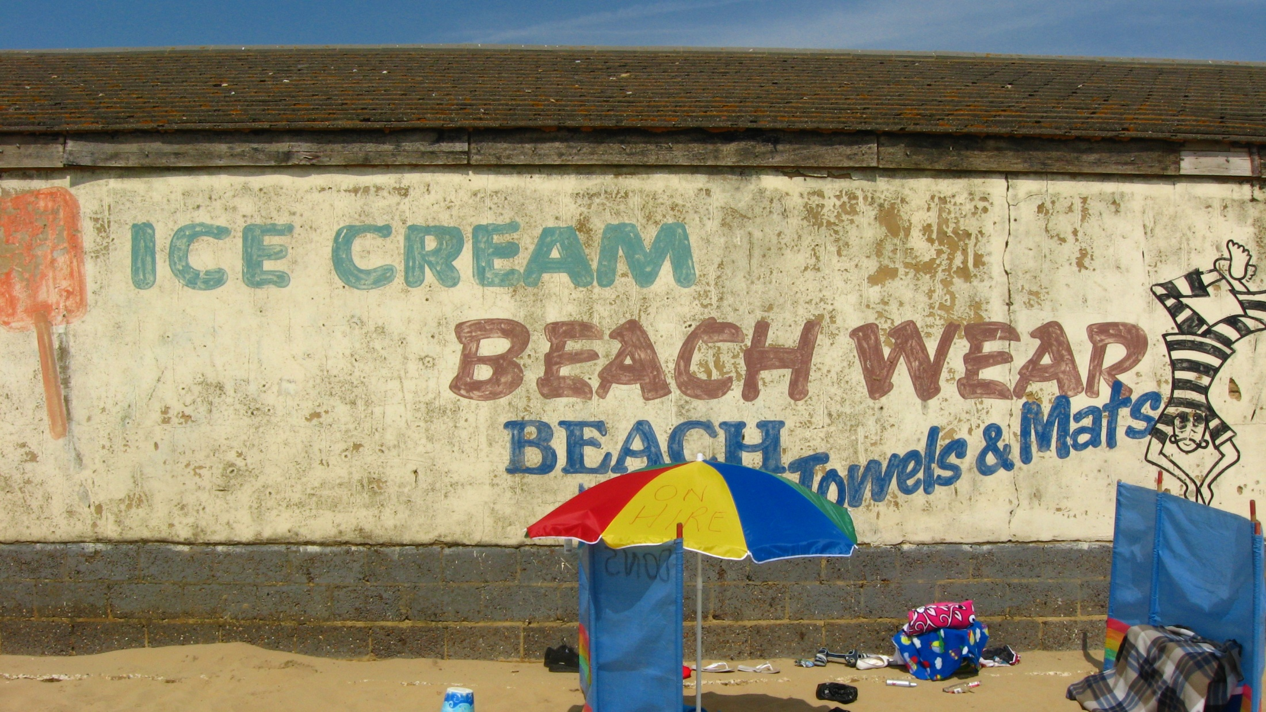
Market

Slide 25
WOMM
KISS
Social Media
Stakeholders

Slide 26
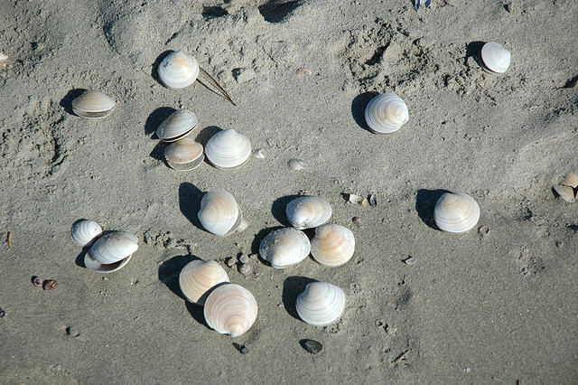
Collect

Slide 27
DUH!
E-book Strategy
Holes?
Know your people!

Slide 28
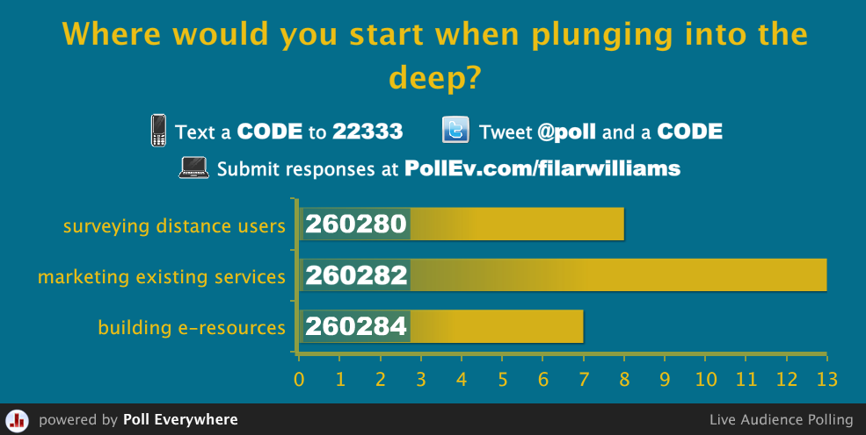
Notes:
Press F5 or enter presentation mode to view the poll In an emergency during your presentation, if the poll isn't showing, navigate to this link in your web browser: http://www.polleverywhere.com/multiple_choice_polls/LTE5NjM4NjYxNTY
If you like, you can use this slide as a template for your own voting slides. You might use a slide like this if you feel your audience would benefit from the picture showing a text message on a phone.

Slide 29
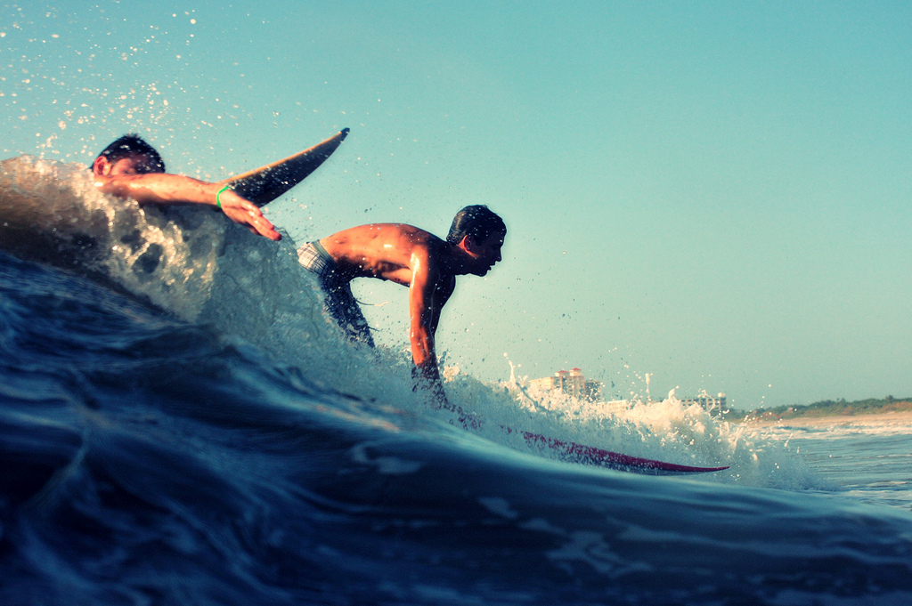
Swim with the Current

Slide 30
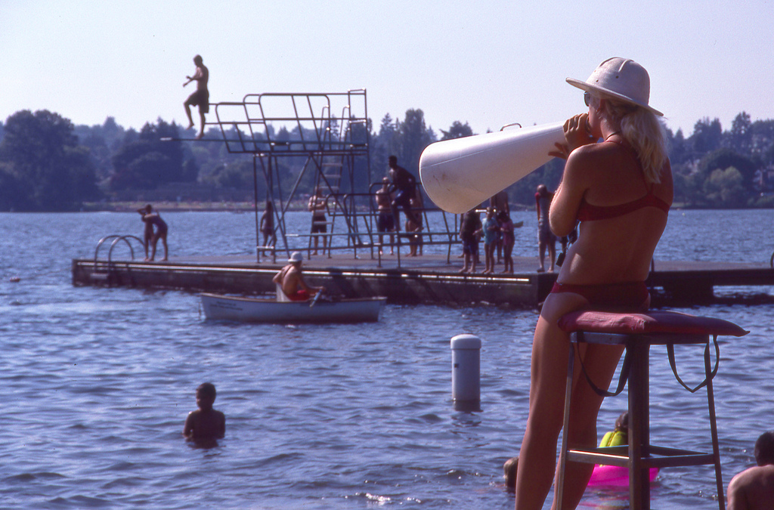
Technology for Outreach

Slide 31
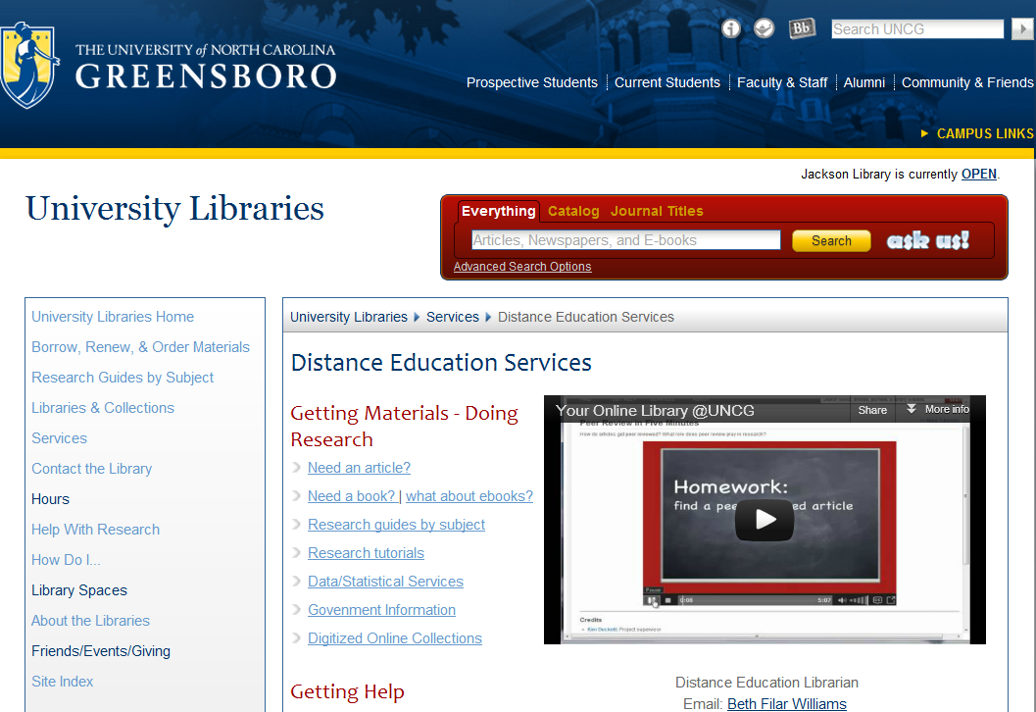
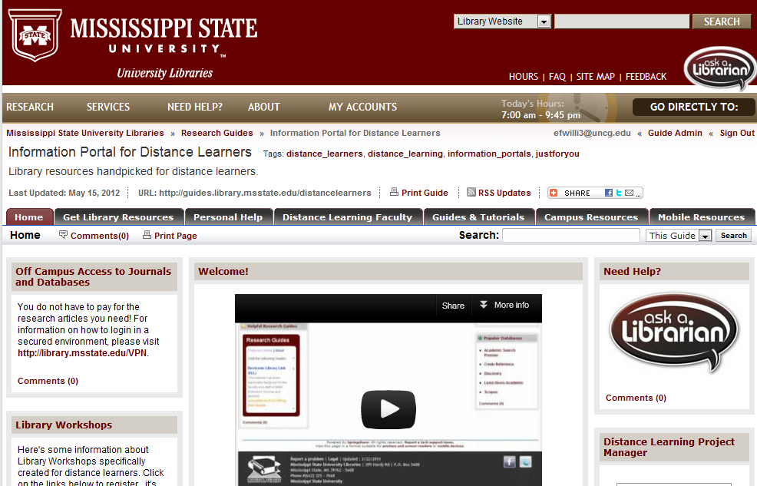
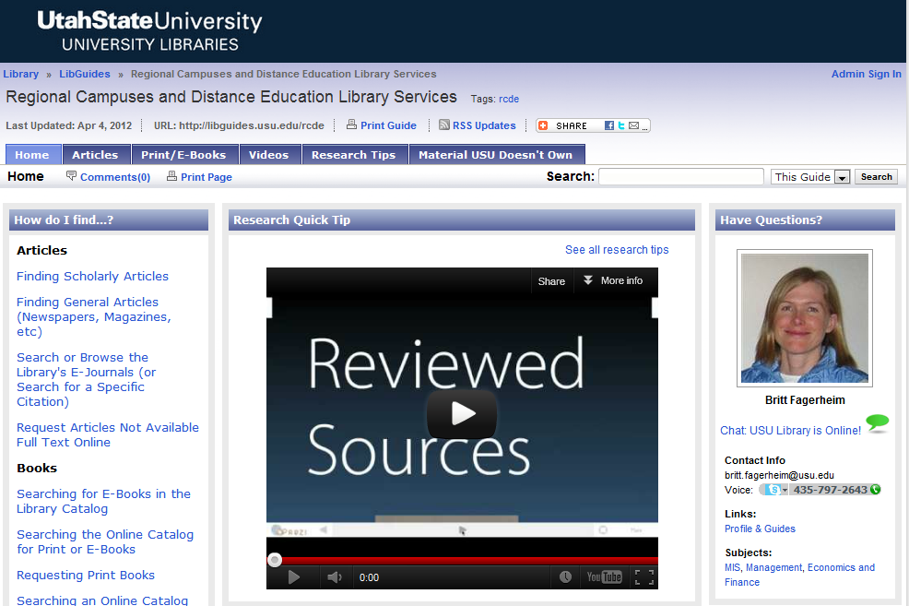
Portal & Orientation Videos

Slide 32
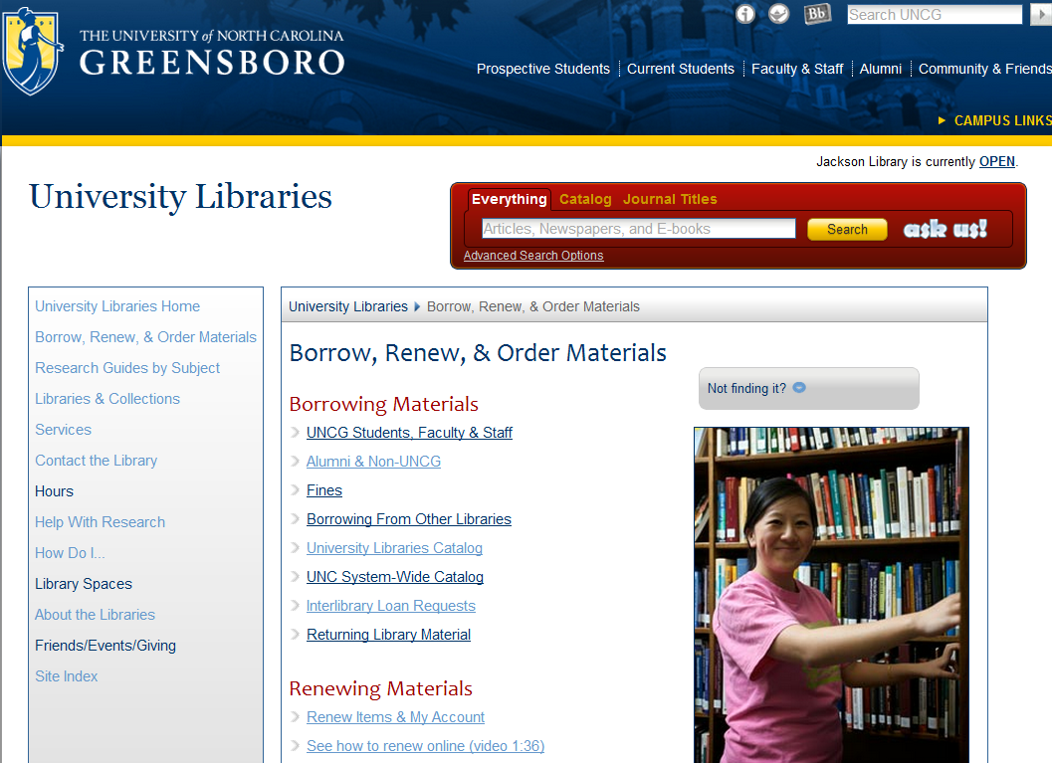
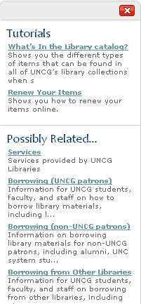
Not Finding it?

Slide 33
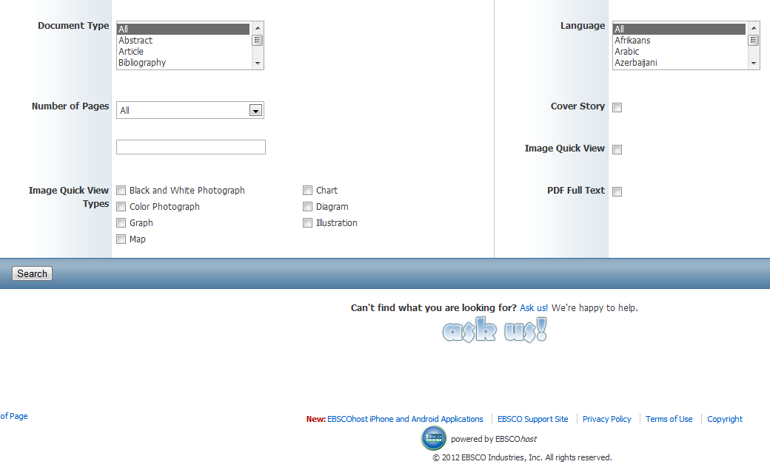
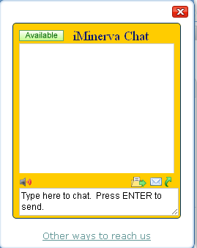
Embed in Databases

Slide 34
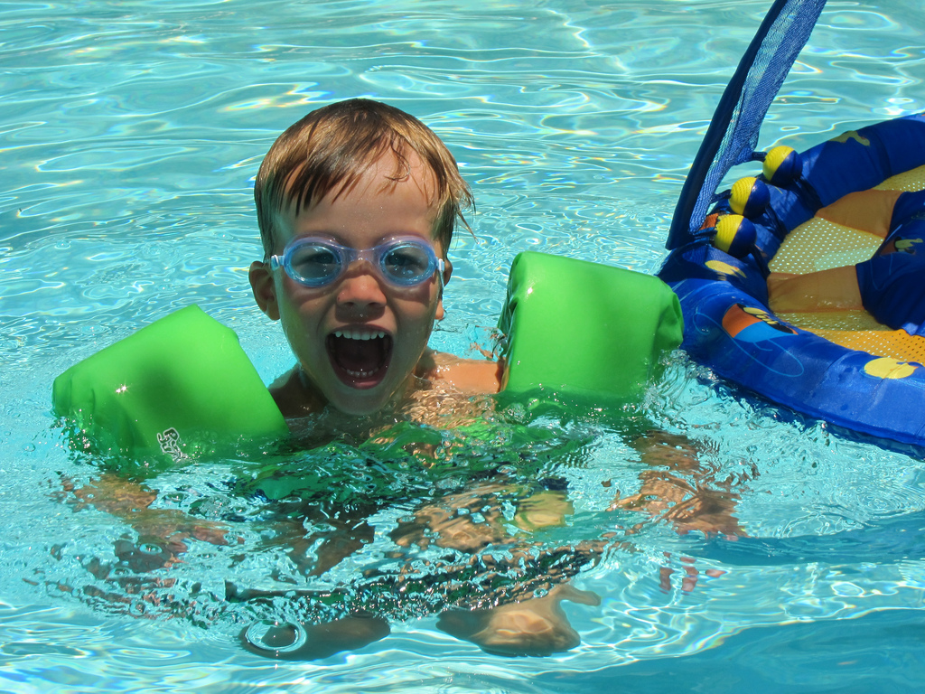
Technology for Instruction

Slide 35
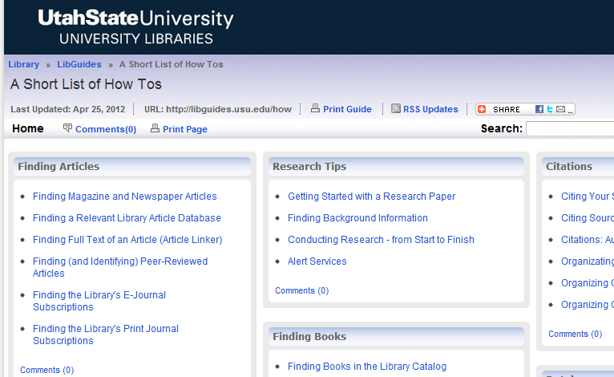
Asynchronous

Slide 36
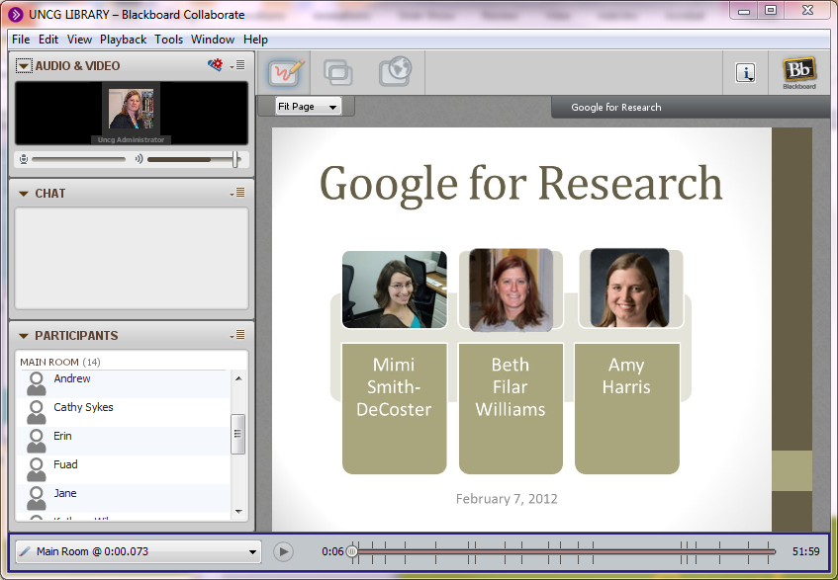
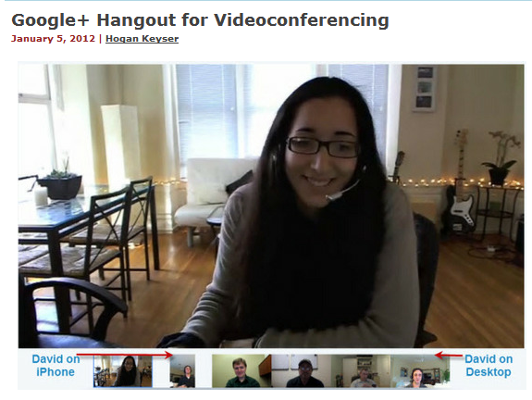
Synchronous

Slide 37
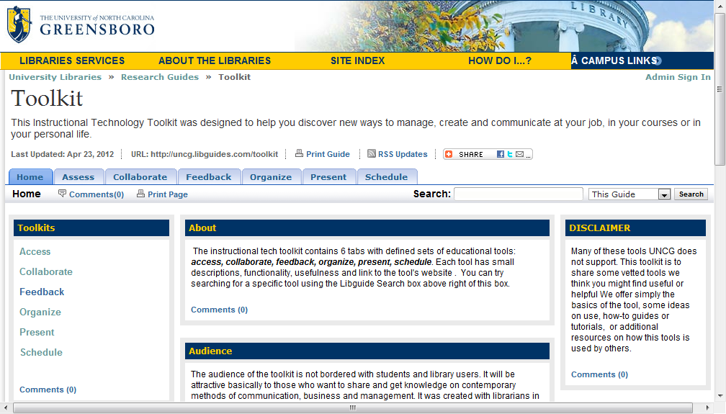
Engaging tools

Slide 38
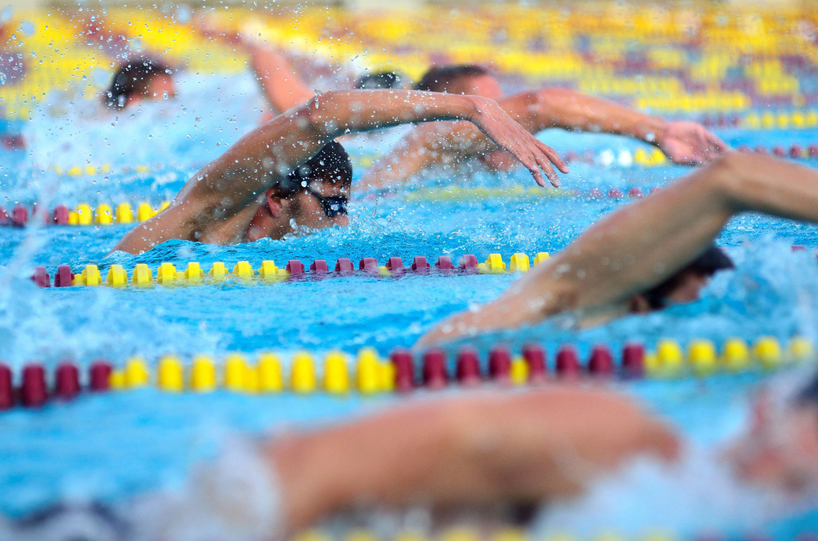
Keep up!

Slide 39
Attend Webinars
Go to Conferences
RSS/Twitter

Slide 40
Have Fun!

Slide 41
Notes:
Press F5 or enter presentation mode to view the poll In an emergency during your presentation, if the poll isn't showing, navigate to this link in your web browser: http://www.polleverywhere.com/free_text_polls/LTE3MzczMDUzODk
If you like, you can use this slide as a template for your own voting slides. You might use a slide like this if you feel your audience would benefit from the picture showing a text message on a phone.

Slide 42
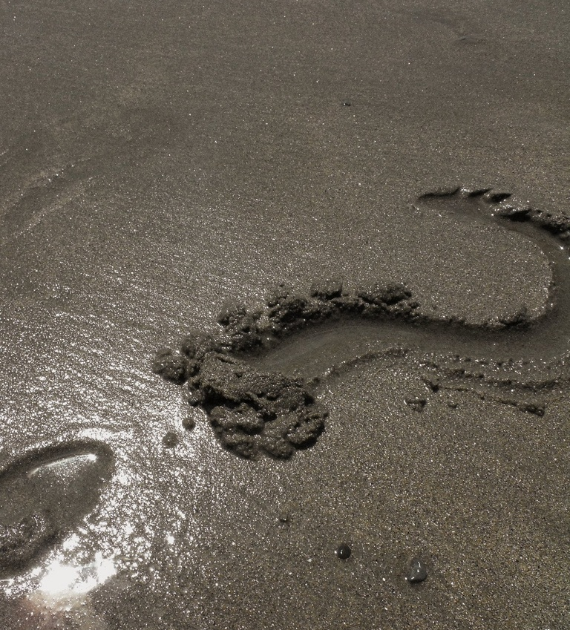

Slide 43
Credits
Color Palette
400 Lovers by Tzadkiel
http://www.colourlovers.com/palette/1276025/400_Lovers
Images (All Creative Commons Licensed and Used Accordingly)
1. Goggles by kaje_yomamma http://www.flickr.com/photos/28504195@N08/4988401680/
2. Drill Field by Roger Smith http://www.flickr.com/photos/65701179@N00/93734151/in/pool-39892358@N00/
3. Map of USU Regional Campuses
4. Northfield by librarianmer http://www.flickr.com/photos/librarianmer/33032390/in/photostream/
5. UNCG Photo by David Wilson - 12/6/05 - Aerial view of the UNCG campus in the evening during the holiday luminaries display.
7. splash by omnia_mutantur http://www.flickr.com/photos/39685874@N00/2814042039/
8. Swarm of Anthias by Erwin Kodiat http://www.flickr.com/photos/99134924@N00/24180432/
9. can you hear it ring? by awkward_er http://www.flickr.com/photos/29163894@N02/3696325069/
10. Yelling or kissing by quinn.anya http://www.flickr.com/photos/quinnanya/4464686019/in/photostream/
11. Save Our Fish! by MadAboutCows http://www.flickr.com/photos/42492293@N00/2933466887/
13. Hello, summer. by SabrinaDan Photo http://www.flickr.com/photos/21187962@N03/3790480831/
14. The incorrect way to hold a crab by pcgn7 http://www.flickr.com/photos/21204781@N07/2355579689/
16. Beach picnic by pinprick http://www.flickr.com/photos/17365783@N00/4900536832/
17. Going fishing by atmtx http://www.flickr.com/photos/atmtx/3855300632/
18. Mondello by Macorig Paolo http://www.flickr.com/photos/71758328@N00/223645219/
21. Scuba by halseike http://www.flickr.com/photos/99624358@N00/5343410373/
22. Sand Castle Construction by jaywood_uk http://www.flickr.com/photos/jaywood/2762736502/in/photostream/
24. img_1279 by acb http://www.flickr.com/photos/37912374670@N01/2493530274/
26. shell collection by steatlhproject2006 http://www.flickr.com/photos/83963643@N00/220764512/
29. Surfing Cocoa Beach Florida by Kevin N. Murphy http://www.flickr.com/photos/knmurphy/3827402016/sizes/l/in/photostream/
30. Day 231/365 - Hey! You in the boat! By Great Beyond http://www.flickr.com/photos/26104563@N00/5041883160/
34. Lucas in the pool by Lars Ploughman http://www.flickr.com/photos/75062596@N00/6316699691/
36. Google+ Hangout from Telepresence Options http://www.telepresenceoptions.com/2012/01/google_hangout_for_videoconfer_1/
38. Freestyling by AdLavinsky http://www.flickr.com/photos/27981682@N05/5109228652/
40. – by Shenghung Lin http://www.flickr.com/photos/40764207@N00/6160659112/
42. (85/365)? by Finding Josephine http://www.flickr.com/photos/34233222@N05/3801511495/
44. Thanks a Bunch by The Stakhanovite Twins http://www.flickr.com/photos/59479249@N00/1254954232/
Notes:
These numbers will need adjusting if more slides are added…DON’T FORGET!!!

Slide 44
Rachel Cannady
Mississippi State University
rcannady@library.msstate.edu
Britt Fagerheim
Utah State University
britt.fagerheim@usu.edu
Beth Filar Williams
UNC – Greensboro
efwilli3@uncg.edu
Heidi Steiner
Norwich University
hsteiner@norwich.edu
http://guides.library.msstate.edu/divingin

