Slide 1
For Service or Profit: A Case Study of a Public Library Café
Dr. Anthony Chow
Barry Bell and Erin Price
Notes:
Dr. Chow

Slide 2
Overview
Study Introduction
Review of the Literature
Method
Results
Discussion and Recommendations
Q&A
Notes:
Dr. C

Slide 3
Introduction
Are the goals of the café well aligned with the goals of the organization and user?
Who currently uses the café and for what purposes?
How can the café become more profitable?
Notes:
Barry B

Slide 4
Review of Literature
Options
“A public library must be very clear as to why it wants to offer a service and whether it expects a profit.” (Reese, 1999)
Traditional café, coffee cart, coffee stand, restaurant or vending machines? (Gerding, 2006)
Unless a staff member has a background in food service, outsourcing the café usually appears the best option. (Reese, 1999)

Slide 5
Review of Literature
For Service or Profit?
Many libraries “mentioned they were more interested in selling ambience, a sense of place and community, than making money.” (Gerding, 2006)
Seattle Public Library hosts a coffee cart staffed by a job-training organization providing jobs for homeless and disenfranchised people. (Wise, 2005)
Philadelphia Free Library collaborates with Project H.O.M.E., who provide on-the-job-training for formerly homeless people. (Price, 2009)

Slide 6
Review of Literature
Marketing
Large, consumer bookstores can be considered libraries biggest competitors. (Dempsey, 2010)
Libraries must brand and market themselves within their communities in order to compete with chains. (Harris, 2007)
Re-envisioning the design/image of a library café (Pierce, 1997) and creating a logo for the sale of branded items can generate a lot of interest. (Dempsey, 2010)

Slide 7
Method
Administrator interviews
focused upon current budget issues, changes in café/shop vision, current/past business models
Observations
focused upon café and bookshop patrons’ behaviors, overall atmosphere, customer service and transactions
Observational interviews
focused upon user perceptions of café services, purposes of use, frequency and duration of use, and overall satisfaction.
Online survey
patrons rated the efficiency, effectiveness, and satisfaction of café goods and services.
Notes:
Dr. Chow

Slide 8
Results: Administrator Interviews
Are the goals of the café well aligned with the goals of the organization and user?
Literature reviewed suggests that many libraries show a greater degree of profit when cafes are run by an outside source or the Friends of the Library
Administrator interviews suggested a disconnect between the vision of the library and the profit motives of the Friends of the Library
Notes:
Barry B

Slide 9
Observations
Who currently uses the café and for what purposes?
Notes:
Barry B

Slide 10
Observations
The level of customer service satisfaction depends on which employee is working.
37 respondents
Notes:
Barry B

Slide 11
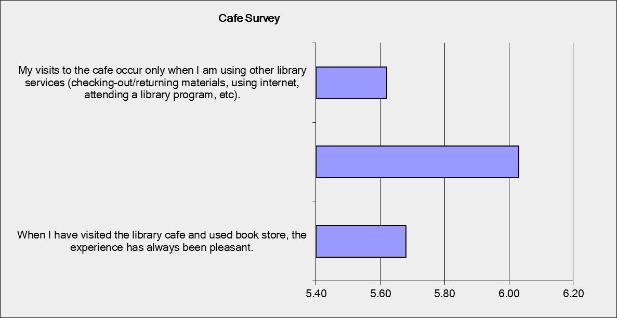
Observations
80-85% of customers using café come from or go to the library (i.e., using other services)
I believe the Cafe in the library offers a needed service to patrons.
61 respondents
Notes:
Barry B

Slide 12
Observations Average customer stayed for no more than 10 minutes.
Of 61 respondents, over 67% stayed 10 minutes or less
Most left immediately after their purchase.
Notes:
Barry B

Slide 13
Clear Vision
For service or for profit? Café or bookstore?
Salaries vs. Profit
Finances show profitability before salaries and payroll taxes
Profit Margins
donated books have no overhead cost
Volume of Sales
food generates 2 to 3 times the amount of revenue that books generate on average
Re-examine Products and Space
consistency in data show users want better quality food items
and less “sterile” environment
Notes:
Dr. Chow

Slide 14
Service Model
Must be willing to forego profit
Redesign staffing model to affect a reduction of salaries/taxes
more volunteers
high-school service projects
job training partnership
Funding model = supplements
grants
corporate sponsorship/donation
Notes:
Dr. Chow

Slide 15
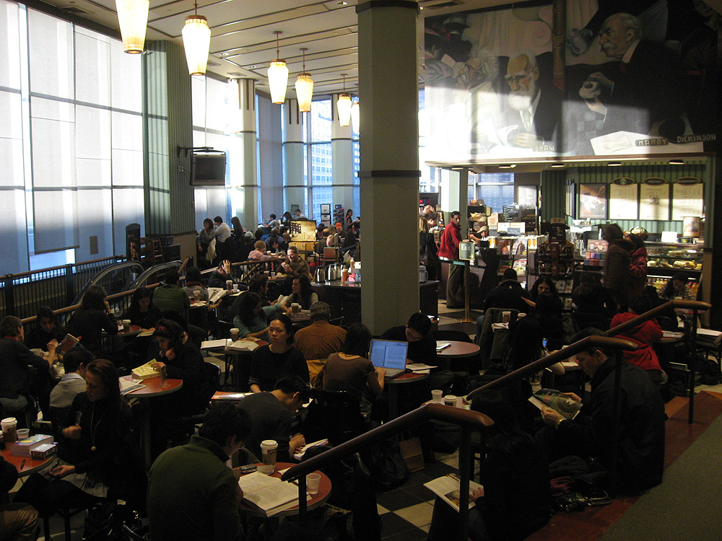
Profit Model – Barnes & Nobles bookstore model
More books in bookshop
Sell food at higher profit margin
more baked goods (cake, pie, muffins)
more variety of products
Targeted toward people with money
Softer, more comfortable design
ambience of relaxation
Re-envision placement of items
Notes:
Dr. Chow

Slide 16
Recommendations. Each plan should include:
Clear goal alignment between all stakeholders
level of service
level of profit
Marketing Campaign
Customer Service Training
Cost analysis of
best selling items
margin of profit on these items
Notes:
Barry B

Slide 17
Winds of Change
Focus shift at the café/bookstore
Shift from quick service to promoting “hanging out”
Music
Okay to sit there as long as they like
Promoting books and staying rather than emphasizing food and beverage and leaving quickly.
Potential for both service (low expense foods) and profit (books 100% profit)
Integrating existing services into the café/bookstore

Slide 18
References
Dempsey, B. (2010). For love or money. Library Journal, 20-23.
Gerding, S. (2006). Fund-raising perks of library cafes. Public Libraries, 40-45.
Harris, C. (2007). Libraries with lattes: The new third place. APLIS, 145-152.
Pierce, W. (1997). Espresso and ambiance: Library cafes. APLIS, 100-103.
Price, W. (2009). The story of the H.O.M.E. page cafe. Public Libraries, 32-34.
Reese, N. (1999). Cafe service in public libraries. Public Libraries, 176-178.
Wise, M. (2005). Books, hot coffee and a comfortable chair. Alki, 11-12.

