Slide 1
School Library Strategic Planning A Panel Discussion
Anthony Chow, Ph.D.
Amy Figley, MLIS candidate
Stephanie Sells, MLIS candidate
--
Sara ralph
Michelle Miliken
Patricia Stringer
Brenda Phetteplace

Slide 2
Overview
Introduction
Literature Review
Method
Results
Panel Discussion
Discussion and Conclusions
Would you like to be involved?
Notes:
Amy

Slide 3
Introduction
Idea formulated from last year’s NCSLMA
What impact would strategic planning have on school libraries?
Four volunteers
Notes:
Amy

Slide 4
The Gap
Many principals believe school libraries are important but do not see the direct link between libraries and student achievement (Lau, 2002).
Many principals do not make the connection between educational theory and the school library (Veltze, 1992).
Principals admit they need more information about school libraries in their educational leadership courses (Wilson and Blake, 1993).
Notes:
Stephanie

Slide 5
Why the gap?
Perceptions from previous school experiences
Lack of education in principal training programs
Isolation of school librarians
Lack of communication between school librarian and principal
(Hartzell, 1997; Hartzell, 2002; Roberson, Applin and Schweinle, 2005)
Systemic problem, systemic solutions -lack of strategic alignment between school and library goals (Chow, Mui, & Gavin, 2008)
Notes:
Stephanie

Slide 6
Organizational Elements Model (Kaufman, 2000)
MACRO
MICRO
Teachers
Students
Librarians
Principal
Library
Classrooms
Technology
PROCESS
Student achievement
Student success
Classes
Fixed Sched.
Flexible Sched.
AR
Notes:
Anthony

Slide 7
Organizational Elements Model (Kaufman, 2000)
MACRO
Is everyone on the same page?
Library
Student achievement
Student success
Students
Teachers
Administration
Notes:
Anthony

Slide 8
Organizational Elements Model (Kaufman, 2000)
MACRO
Get everyone on the same page?
Student achievement
Student success
Students
Library
Administration
Teachers
Notes:
Anthony

Slide 9
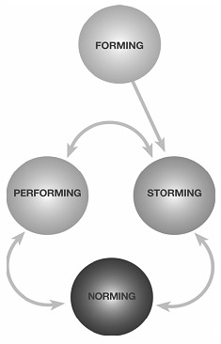
Norms of Group Development (Tuckman, 1965)
Forming – Group gets to know each others’ strengths and weaknesses
Storming – Conflict representing differing views and values
Norming – Conflict is resolved through “norming” process of understanding how to work together.
Performing – Team works together emphasizing strengths not weaknesses, similarities not differences.
Source: University of Queenlsand Website
Notes:
Anthony

Slide 10
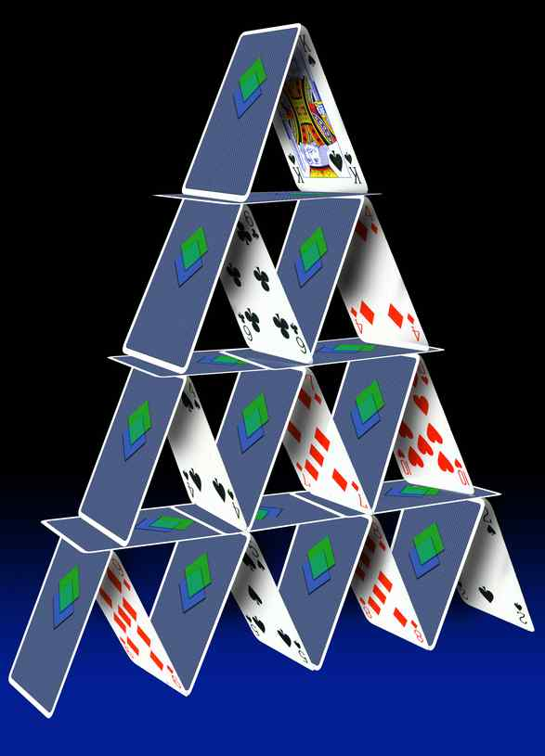
Closing the gap:
#1 Align library goals with stakeholders

Slide 11
How do you ensure your goals are in line with your stakeholders?

Slide 12
Things you can do….
Develop a strategic plan with a few strategic goals for the year:
Involve school stakeholders – students, administration, teachers, and parents.
Ask, “how can I help you achieve your goals? Build on existing goals students, teachers, and administrators already have.
Add some of your own!
Identify “best practices” as resources you seek
Developing a strategic plan (Lyddon, 1999)
Notes:
Amy

Slide 13
Strategic Plans
Vision
Mission
Core Values
Core Competencies
Goals & Objectives
Notes:
Anthony

Slide 14
Results

Slide 15
Results – 12 Questions
Question # | Question | Pre Avg. | Post Avg. | Difference
12 | This last year, I have had the opportunity at work to learn and grow. | 6.3 | 5 | -1.3
1 | I know what is expected of me at work. | 5.8 | 6 | 0.3
6 | There is someone at work who encourages my development. | 5.5 | 5.5 | 0.0
3 | At work, I have the opportunity to do what I do best everyday. | 5.3 | 5.0 | -0.3
2 | I have the materials and equipment I need to do my work well. | 5.0 | 4.0 | -1.0
8 | The mission/purpose of my school makes me feel my job is important. | 5.0 | 4.5 | -0.5
9 | My co-workers are committed to doing quality work. | 4.5 | 5.5 | 1.0
5 | My supervisor or someone at work seems to care about me as a person. | 4.0 | 6.5 | 2.5
4 | In the last seven days, I have received recognition or praise for doing good work. | 3.8 | 3.0 | -0.8
10 | I have a best friend at work. | 3.8 | 3.0 | -0.8
11 | In the last six months, someone at work has talked to me about my progress. | 3.8 | 4.5 | 0.8
7 | At work, my opinions seem to count. | 3.3 | 5.0 | 1.8
 |  | 4.6 | 4.8 | 0.1
Notes:
Stephanie

Slide 16
Method
Four case studies (the past six months)
Two elementary schools
One middle school
One high school
Each were asked to:
Ideal vision
Needs assessment
Teacher satisfaction, Parent satisfaction,
School Librarian Job Self-Efficacy and Social Information Scale
Advisory committee
Strategic plan
Notes:
Stephanie

Slide 17
School Librarian Job Self-Efficacy and Social Information Scale Results (3) – Pretest summary of all four
Notes:
Anthony

Slide 18
Self-efficacy and confidence is flowering!
Notes:
Anthony

Slide 19
Scale Composite Scores
 | SL1 |  | SL2
 | Pre | Post | Pre | Post
SESIS | 5.2 | 5.4 | 4.0 | 5.4
Teacher Satisfaction | 5.33 | ? | 5.19 | ?
12 Questions | 5.2 | 4.6 | 3.8 | 5.0
Notes:
Anthony

Slide 20
Panel Discussion
How was your experience with the strategic planning process?
What impact do you feel it has had on:
Confidence
Relationships with major stakeholders
School library in general (resources, perceptions, etc.)
Thoughts and recommendations to other school librarians?
Notes:
Anthony

Slide 21
Final Thoughts
Strategic planning is an affirmative way to focus on the future and build a collaborative vision
The path is not easy – remember forming, storming, norming, and performing!
True “quality” always takes enormous and consistent amounts of work and effort
“Don’t get mad, take action!”
My book Library Technology and User Services (Chow & Bucknall, 2011) addresses all of this within the context of technology usage and national trends….
Notes:
Anthony

Slide 22
Are you interested?
I would be happy to:
Provide you with our online strategic planning instrument
Email support if needed
Provide you access to the self-efficacy and social information diagnostic scale
Just leave me your name and email address and we will be in touch with you
I just want your data (completely anonymous and confidential) to help refine and validate the instruments so they are truly effective and worthwhile….
The slides will be available at anthonyschow.wordpress.com
Notes:
Anthony

Slide 23
Thank You!

Slide 24
References
Chow, A., Mui, Z, & Gavin, R. (2008, October). Quality Media Centers, Quality Schools - is there really a
connection? Paper presented at the North Carolina School Library Media Association Conference.
Hartzell, G. (1997). The invisible school librarian. School Librarian Journal, 43, 24-29.
Hartzell, G .(2002). Why should principals support school libraries? ERIC Clearinghouse in Information
and Technology (ED 470034).
Kaufman, 2000.
Lau, D. (2002). What does your boss think about you? School Library Journal, 48(9), 52- 55.
Lyddon, 1999
Roberson, T.J., Applin, M.B., & Schweinle, W. (2005). School libraries’ impact upon student achievement
and school professionals’ attitudes that influence use of school library programs. Research for Educational Reform, 10(1), 45-52.
Veltze, L. (1992). School library media program information in the principalship preparation program.
School Library Media Annual, 10, 129-34.
Tuckman, B. & Jensen, M.A. (1977). Stages of Small-Group Development Revisited. Group &
Organization Studies (pre-1986) vol. 2 (4), pg. 419-427.
Wilson, P. & Blake, M. (1993). A plan and a study for partnership. Emergency Librarian.21(1), 19-24.

