Slide 1
School Library Website Usability
Anthony Chow, Ph.D.
Amy Figley, MLIS candidate
Jessica Sherard, MLIS candidate

Slide 2
Overview
Introduction
Literature Review
Method
Results
Discussion and Conclusions

Slide 3
Introduction
UNCG summer funded project
How do school library websites compare to recommended best practices?
Who are school library websites designed for?

Slide 4
Literature Review
Children have different information seeking needs than adults (Cooper, 2005; Nielson, 2010)
Three research trends have emerged
Cognitive
Affective
Design

Slide 5
Literature Review (2)
Cognitive
Age Appropriateness
Amount of text on a page (Bilal, 2005)
Vocabulary (Cooper, 2005; Dubroy, 2010)
Graphics (Large, Behesti, & Rahman, 2002)
Cues (Rose, Rose, and Blodgett, 2009)
Pictorial searching (Rose, Rose, and Blodgett, 2009)
Icons to represent ideas (Cooper, 2005; Dubroy, 2010)
Games (Nielsen, 2010)

Slide 6
Literature Review (3)
Affective
Emotionally safe environment (Bilal, 2005; Kuhlthau, 1991)
Minimize uncertainty and fear of failure by providing feedback and using clear organization (Bilal, 2005)
Motivate through:
Image (Cooper, 2005)
Sound (Cooper, 2005)
Interactivity with others (Teo, Oh, & Lui, 2003; Bilal, 2005; Dubroy, 2010)
Personalization (Large, Beheshti and Rahman, 2002; Dubroy 2010)
Play (Dubroy, 2010; Large et al., 2002; Cooper, 2005).
Open exploration (Bilal, 2005)
Self-paced (Cooper, 2005)

Slide 7
Literature Review (4)
Design
Child-centered approach (Bilal, 2002; Large, Beheshti, & Rahman, 2002; Large, Beheshti, Nesset, & Bowler, 2004)
Control the pace and create own path (Cooper, 2005)
Ability to leave a footprint (Bauman, 2009; Large et al., 2002; Dubroy, 2010)
Simple layouts (Cooper, 2005; Nielson, 2002) containing:
Bright colors (Bilal & Kirby, 2002; Bilal, 2005; Dubroy, 2010; Large, Beheshti, & Rahman, 2002; Large, Beheshti, Nesset, & Bowler, 2004)
Site mascots (Bowler, 2004)
Creative icons (Bowler, 2004; Large et al., 2004)
Fun name (Large, Nessit, Beheshti and Bowler 2004)
Animation and graphics (Bowler, 2004; Large et al., 2002; Dubroy, 2010; Large et al., 2004; Nielsen, 2002)
Characterization (Bowler, 2004)
Logo in upper left corner (Nielsen, 2004; Nielsen, 2010)
Search box on homepage with keyword searching (Nielsen, 2004)
No splash page (Nielsen, 2004; Nielsen, 2010)
Horizontal breadcrumbs (if used) (Nielsen, 2004; Nielsen, 2010)

Slide 8
Method
Sampling
Random selection of one rural and one urban county for every state
Random selection of one elementary, middle, and high school per county
Total of 300 school libraries selected
Assessment of 104 completed
Rated each website on a ten point scale
Lowest (1)
Highest (10)

Slide 9
Method (2)
The School Usability Checklist was used to collect data on the following items:
Site information
For identification purposes and general information
Cognitive features
(Bilal, 2002; Large, Behesthi, & Rahman, 2002; Large, Behesthi, Nesset, & Bowler, 2004; Cooper, 2005; Nielsen, 2002; Bilal & Kirby, 2002; Bilal, 2005; Dubroy, 2010; Large et. al., 2002; Large et. al., 2004; Rose, Rose, & Blodgett, 2009; Nielsen, 2010)
Affective features
(Bilal, 2005; Kuhlthau, 1991; Cooper, 2005; Teo, Oh, & Lui, 2003; Dubroy, 2010; Large et. al., 2002; Large et. al., 2004; Kuhlthau, 1993 in Bilal, 2005; NAEYC, 1997 in Bilal, 2005; Nielsen, 2010; Bauman, 2009)
Design
(Bilal, 2005; Cooper, 2005; Nielsen, 2004; Nielsen, 2010; Lavie & Tractinksy, 2004; Lavie, 2004 in Deng, 2010; Deng, 2010)
Feature placement
(Nielsen, 2010; Nielsen, 2002; Nielsen, 2004; Bilal, 2005; Dubroy, 2010; Teo et. al., 2003)
Content Checklist
What resources can be accessed through the website

Slide 10
Method (3)
School Librarian Website Survey
Survey created to get input from the librarian
Asked who the site is designed for
Students, Parents, Teachers, or Administrators
Checklist for resources and services provided
Physical and electronic resources
Instruction or training
Place for socialization or group learning
Priority services and resources
Rank order the top five services and resources in the library's opinion
Primary utilization of their services and resources
Rank order the top five resources that are used
Site management
Who manages the site
Is there adequate funds for site management
Is there adequate training for site management

Slide 11
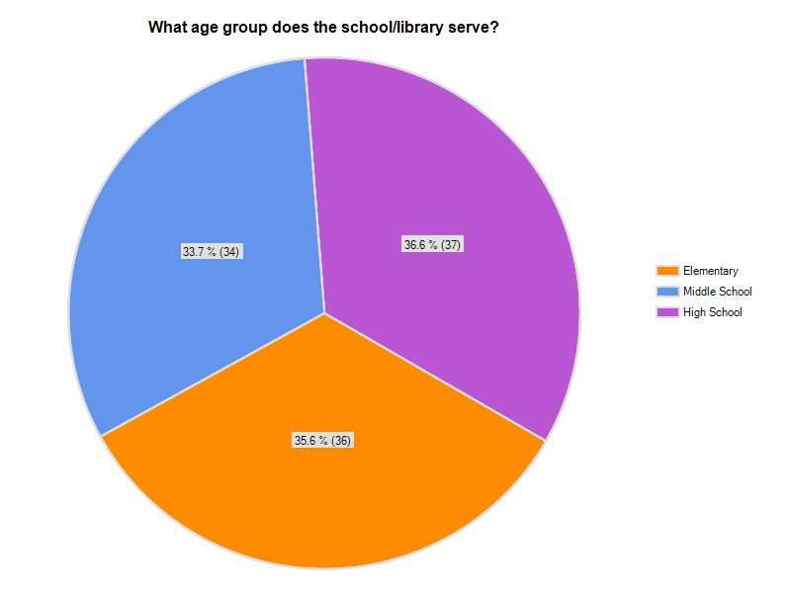
Results
What is Being Done Well?
Most school libraries do have websites (89.1%)
Age appropriate graphics and vocabulary
Average rating of 5.16 out of 10
Access to OPAC (62.2%)
Offer electronic resources and databases (69.3%)
Contain information literacy resources
Average rating of 4.4 out of 10
Notes:
Try to find a graph/percentage for these bullets

Slide 12
Results (2)
Areas for Improvement
Area | Average Rating on 10 point scale (1 = Lowest, 10 = Highest
Bright and Engaging Colors | 3/24
Animation | 1.06
Sound Effects | .27
Search Tips | 2.69
User Control | 1.62
Opportunities to Leave a Footprint | .66
Trial by Error with Physical Objects | 2.26
Encouraging Exploration by Being Open Ended | 2.26
Responding to Child Input | 1.09
Active Design | 1.73
Use Significant Icons | 2.64
Quick Feedback | 1.66
Supporting Social Interaction | .58

Slide 13
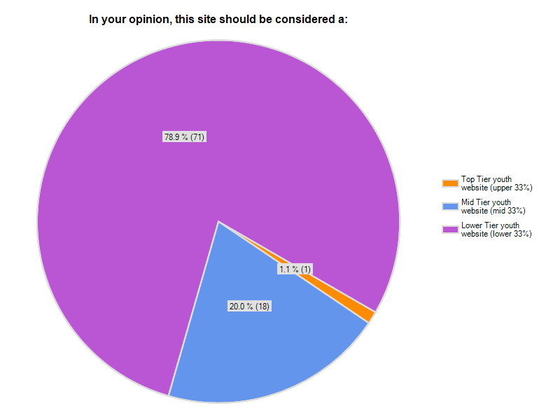
Results (3)
Who was in mind when the website was designed?
85.7% of librarians say their website was designed for students
41.1% of websites were designed for adults according to our study

Slide 14
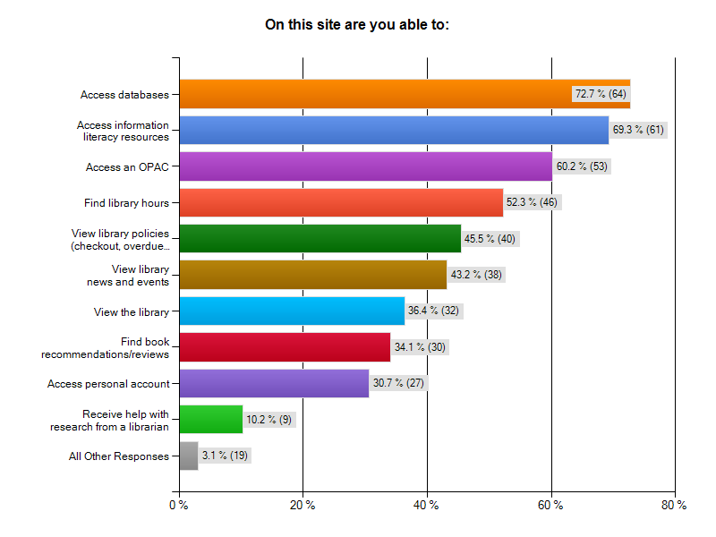
Results (4)

Slide 15
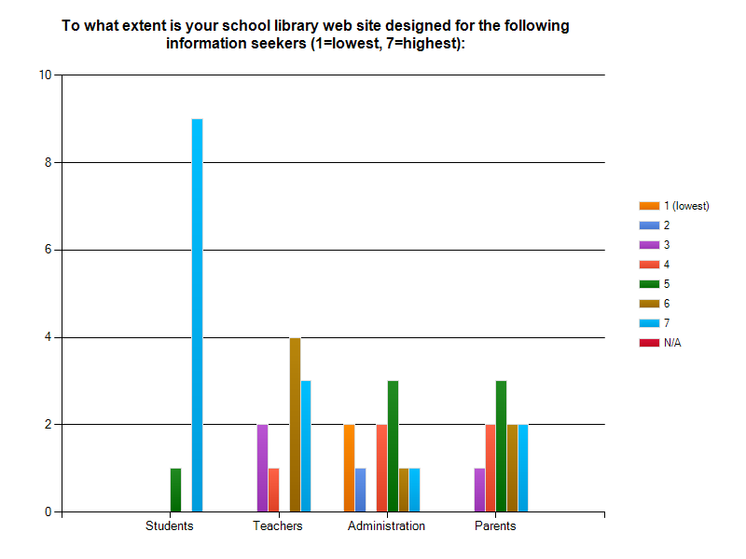
Results (5)
Twelve librarians have completed the School Librarian Website Survey
Of the twelve, six worked in high school libraries, three worked in middle school libraries, and three worked in elementary libraries.

Slide 16
Discussion and Conclusions
Many websites house good information, but most do not use the best practices in design for youth websites.
Librarians may not have the resources to meet all of the needs.
Should LIS programs educate future librarians about best practices when creating websites?
Should Librarians participate in professional development workshops that teach these best practices?
Example websites:
http://www.newhtfd.org/5033_4242813253/site/default.asp
http://eisenhower.jsd117.org/?PageName=%27Library%27
Notes:
Show an example - find a couple of library websites and we can visit the
good website and one not as good

Slide 17
Final Thoughts
By using the best practices, librarians can ensure that students are motivated to use the library website and its resources
Including children in the website designing process will allow for a child's perspective to directly influence the website designed (Bilal, 2002; Large, Beheshti, & Rahman, 2002; Large, Beheshti, Nesset, & Bowler, 2004)

Slide 18
References
Bauman, 2009
Bilal, D. (2005). Children's Information Seeking and the Design of Digital Interfaces in the Affective Paradigm. Library Trends, Vol. 54, No. 2, Fall 2005
Bilal, D. & Kirby, J. (2002). Differences and similarities in information seeking: children and adults as Web users. Information Processing and Management 38 (2002) 649–670.
Bowler, 2004
Cooper, L. Z. (2005). Developmentally Appropriate Digital Environments for Young
Children. Library Trends , 54 (2), 286-302.
Deng, L., & Poole, M. S. (2010). Affect in Web Interfaces: A Study of the Impacts of
Web Page Visual Complexity and Order. MIS Quarterly , 34 (4), 711-730.
Dubroy, M. (2010). Building Virtual Spaces for Children in the Digital Branch. The
Australian Library Journal , 211-223.
Kuhlthau, C. C. (1991). Inside the Search Process: Information Seeking from the User’s
Perspective. Journal of the American Society for Information Science , 42 (5),
361-371.
Kuhlthau, C. (1993). Seeking meaning: A process approach to library and information
services. Norwood, NJ: Ablex.
Large, A., Beheshti, J., & Rahman, T. (2002). Design Criteria for Children’s Web
Portals: The Users Speak Out. Journal of the American Society for Information
Science and Technology , 53 (2), 79-94.

Slide 19
References (2)
Large, A., Beheshti, J., Nesset, V. & Bowler, L. (2006). Web portal design guidelines
as identified by children through the processes of design and evaluation.
Paper presented at the American Society for Information Science and Technology Meeting, Silver Springs, MD.
Lavie & Tractinksy, 2004
NAEYC, 1997 in Bilal, 2005
Nielsen, 2004
Games (Nielsen, 2010)
Nielson, 2002
Rose, M., Rose, G. M., & Blodgett, J. G. (2009). The Effects of Interface Design and Age
on Children’s Information Processing of Web Sites. Psychology & Marketing , 26
(1), 1–21.
Interactivity with others (Teo, Oh, & Lui, 2003;

